Slide 1
Volunteer Activation Kit

Slide 2

Welcome to Next Engineers
Thank you for stepping forward to volunteer with Next Engineers. Volunteers play a critical role in helping us build the next generation of curious minds.
Engineers build worlds. All kinds of worlds. Worlds that haven’t even been thought of yet. Today’s young people are indispensable to building a world that works.
That’s why we created Next Engineers. Next Engineers helps young people discover their inner engineer. Next Engineers offers three inspiring programs to engage diverse students ages 13-18 on their paths to engineering studies: Engineering Discovery, Engineering Camp / Experience, and Engineering Academy.
All GE employees can get involved. Your experiences and unique career journey can excite an interest in engineering and inspire young people to pursue further education and a career in engineering. Together, we can achieve our goals.
This Volunteer Activation Kit highlights how GE employees can engage in Next Engineers. It is THE source for all that you need to know: how to get started, share your story, engage in engineering activities, and get the most out of your volunteering experience.

Slide 3
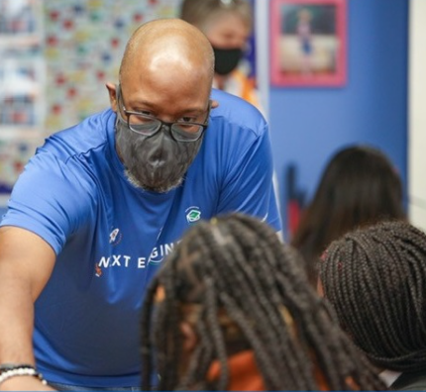

Volunteer Activation Kit
Table of Contents
This kit highlights how GE employees can engage in Next Engineers. It is divided into three sections. Click on each section to learn more:
  GET INFORMED
  Have questions about Next Engineers? This Q&A section has all the answers you need.
  GET INVOLVED
  Ready to get started? This section will help you find the right volunteer opportunity and understand what to expect from your volunteer experience.
  GET STARTED
  This section will prepare you for a successful volunteer experience.
1
2
VOLUNTEER TIP!
To use this Activation Kit and access the associated resources and links you MUST have an account with NextEngineers.org; click the login button to create an account.

Slide 4


Table of Contents
GET INFORMED
Learn more about Next Engineers
Click on the links below to learn the key information about Next Engineers and volunteering with the program.
Here’s HOW
Get oriented with Next Engineers. Learn more about the 5 Building Blocks of Next Engineers and our programs!
Learn about the Next Engineers Locations.
Understand the roles and responsibilities of the Partners & GE Leads.
Review the Volunteer Policies & Procedures, which outline GE’s expectations for volunteers, code of conduct, and our safeguarding procedures.
FOR MORE INFORMATION
Go to NextEngineers.org.

Slide 5






Table of Contents
Next Engineers
The 5 Building Blocks of Next Engineers
Get Informed
We identified 5 essential building blocks to becoming an engineer. These building blocks serve as the foundation of Next Engineers. Check out The Five Building Blocks of Next Engineers for more information and evidence!
Agency
I am actively planning to become an engineer
Engineering Identity
I see myself as an engineer
Engineering
Habits of Mind
I think and act like an engineer
Interest
Engineering is interesting and I think I want to be an engineer
Awareness
I know what engineering is and what engineers do
Notes:
Amanda
Building blocks are key youth pursuing engineering.
Interest & Awareness are the foundational elements – without these, habits & identify can’t be achieved.
Not static. Developed over time. Through social processes and shared experiences – in school and out of school.
Exposure to diverse role models – people whose behavior, example, or success can be emulated by others – are critically important and a powerful message for young women and girls.
As a volunteer, we can strive to provide opportunities and experiences to promote Interest and Awareness.
It is important to remember that during the time—even minimal amounts—spent with young people, you can serve as a role model. Exposure to female role models has been shown to improve performance on tests and to invalidate stereotypes. No matter which STEM2D category, a female role model can be found. It is important to show and teach the stories of women.
But, as volunteers we should “do no harm”
The number one reason
#1 reason of negative ABSENTEEISM
Search Institute: 22% (1 in 4 students) have no developmental relationships parents, siblings, friends,

Slide 6



Each Next Engineers program, Engineering Discovery, Engineering Camp, and Engineering Academy, addresses at least two essential building blocks. Keep going to read more about our programs!
Table of Contents
Next Engineers
Alignment of the 5 Building Blocks & Next Engineers Programs
Get Informed
Agency
Engineering Academy
Engineering Identity
Engineering Camp
Engineering
Habits of Mind
Interest
Engineering Discovery
Awareness
Notes:
Amanda

Slide 7



Table of Contents
Next Engineers
Inspiring the Next Generation of Engineers
Get Informed
Next Engineers helps young people discover their inner engineer. Next Engineers offers three inspiring programs to engage diverse students ages 13-18 on their paths to engineering studies:
Engineering Discovery
Opportunities to explore and discover
Engineering Camp / Experience
An immersive learning experience
Engineering Academy
A transformative learning experience
Students (ages 13 to 14) participate in short, exploratory experiences and hands-on activities that are designed to connect students to real engineers, build awareness about what they do, and highlight the broad array of engineering careers and opportunities.
Young people (ages 14 to 15) apply to attend a week-long immersive experience where they are exposed to engineering facilities and educators, complete design challenges that address real-world problems, and interact with professional engineers and other business leaders.
A three-year program that offers young people (ages 15-18) the opportunity to complete 80 hours of additional learning and enrichment activities that helps them learn to think and act like engineers and prepare for post-secondary engineering studies. Young people who pursue further education in engineering will be offered financial support.
Engineering Discovery targets students in:
Johannesburg, South Africa: Grade 8
Staffordshire, U.K.: Year 9
U.S. Locations: Grade 8
Engineering Camp / Experience is available to young people in:
Johannesburg, South Africa: Grade 9
Staffordshire, U.K.: Entering years 10 and 11
U.S. Locations: Entering grades 9 or 10
Young people can begin Engineering Academy in:
Johannesburg, South Africa: Grade 10
Staffordshire, U.K.: Year 11
U.S. Locations: Grade 10

Slide 8

Table of Contents
Next Engineers
Global Impact & Locations
Get Informed
By 2026, Next Engineers expects to reach 14,000 young people from across our four global locations. Click on each location to find location-specific profiles, investment, partners and leadership structure, upcoming activities, and how to join.
Global Impact
GLOBAL LOCATIONS
In the first year of Next Engineers…
OVER 7,000 STUDENTS AND FAMILIES WERE INSPIRED BY ENGINEERING DISCOVERY
OVER 800 YOUNG PEOPLE ATTENDED ENGINEERING CAMP/ EXPERIENCE
204 YOUNG PEOPLE ENROLLED IN ENGINEERING ACADEMY
To see up-to-date engagement numbers, visit the Next Engineers Global Dashboard.
CINCINNATI, OHIO
GREENVILLE, SOUTH CAROLINA
JOHANNESBURG, SOUTH AFRICA
STAFFORDSHIRE, UNITED KINGDOM
SEVERAL CITIES AROUND THE WORLD ARE ORGANIZING ENGINEERING DISCOVERY ACTIVITIES IN THEIR COMMUNITIES! FOR MORE INFORMATION, SEE GLOBAL DISCOVERY.
8

Slide 9
Table of Contents
Next Engineers Partners and GE Leads
Each global Next Engineers location has a local Community Partner, responsible for local program implementation, and a GE Next Engineers Team responsible for mobilizing volunteers. Roles and responsibilities for the GE team members are listed below.
Get Informed
WHO? | GE Local (City) Lead | Communications Lead | Discovery Lead | Camp/ Experience Lead | Academy Lead
WHAT is their role? | Encourage and support organization's employee engagement in Next Engineers. | Lead local Next Engineers communications to GE employees and company stakeholders. | Lead the employee engagement effort for Engineering Discovery. | Lead the employee engagement effort for Engineering Camp / Experience. | Lead the employee engagement effort for Engineering Academy.
WHAT are their responsibilities? | Relay employee engagement information to business leadership. | Communicate local volunteering opportunities to GE employees. | Receive Discovery event schedule from Community Partner. | Connect with Community Partner to determine volunteer roles and volunteer schedule for Camp/Experience. | Connect with Community Partner to determine volunteer roles and volunteer schedule for Academy.
 | Address any questions or concerns regarding employee engagement from program leads. | Collaborate with local community partner to communicate program impact to GE employees and company stakeholders. | Recruit volunteers per event schedule. Track volunteer sign ups and relay volunteer information to Community Partner. Ensures the Community Partner sends event logistics e-mail to volunteers. | Recruit volunteers per volunteer schedule. Track volunteer sign ups and relay volunteer information to Community Partner. Ensures the Community Partner sends event logistics e-mail to volunteers. | Recruit volunteers per volunteer schedule. Track volunteer sign ups and relay volunteer information to Community Partner. Ensures the Community Partner sends event logistics e-mail to volunteers.
 | Coordinate and facilitate standing check in meetings with GE Next Engineers Team and Community Partner. | Collaborate with local community partner to amplify Next Engineers opportunities through local GE channels. | Check in with volunteers prior to activity to ensure they received logistics information and are prepared to volunteer. | Check in with volunteers prior to activity to ensure they received logistics information and are prepared to volunteer. | Check in with volunteers prior to activity to ensure they received logistics information and are prepared to volunteer.
 |  |  | Coordinate volunteer training with FHI 360. Content will address topics such as working with youth, volunteering tips, and participant safeguarding, and more as needed. | Coordinate volunteer training with FHI 360. Content will address topics such as working with youth, volunteering tips, and participant safeguarding, and more as needed. | Coordinate volunteer training with FHI 360. Content will address topics such as working with youth, volunteering tips, and participant safeguarding, and more as needed.
 |  |  | Following activity, thank volunteers for their support and ensure volunteer data is accurately reflected in Next Engineers global dashboard. | Following activity, thank volunteers for their support and ensure volunteer data is accurately reflected in Next Engineers global dashboard. | Following activity, thank volunteers for their support and ensure volunteer data is accurately reflected in Next Engineers global dashboard.

Slide 10
Table of Contents
Volunteer Policies & Procedures
Get Informed
Local Volunteer POLICIES
Most GE locations have specific volunteer policies. Many are specific to the location and/or country. Volunteers must adhere to all local laws, student protection policies, and regulations by which they are governed.
Volunteer code of conduct
Beyond policies, volunteers should demonstrate the following key behaviors while volunteering.
Lead by Example | Seeing adults model behaviors and roles can powerfully impact young people's development. It is important to remember that during your time — even minimal amounts — spent with young people, you serve as a role model. Exposure to female role models has been shown to improve an engineering mindset.
Be Professional | Exhibit professionalism at all times. Dress modestly and appropriately; wear business appropriate (or GE / Next Engineers) attire, unless otherwise advised. Create a learning environment where young people can do their best work and be proud of the work they accomplished.
Be Respectful | Respect and treat young people fairly and kindly. Emphasize the value of others. Honor their integrity without prejudice to their economic status, abilities, race and customs, or cultural and religious needs. Avoid criticizing, rejecting wrong answers, or disciplining students.

Slide 11
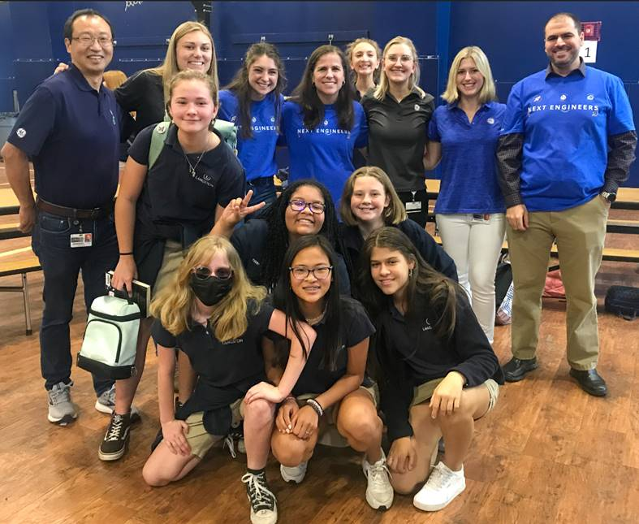
Table of Contents
Get Informed
Be Responsible | Be punctual for your voluntary duties. If you sign up, show up! If unable to attend, inform a member of the GE Next Engineers Team or the Community Partner contact as early as possible. Clean up; leave the space better than you found it. Be mindful that ultimately you are representing the GE brand.
Be Relatable | Young people have unique social, personal, and academic needs. Approach them with sincerity and respect.
Be Present | Put away mobile phones, tablets, and other technology. Strive to actively listen to and engage all young people.
Be Discerning | Behave in the most appropriate or desirable manner during the activities that will not create liability or bring GE into disrepute. Ensure the safety of all participants. Do not hesitate to speak up or act in the interest of safety. Report any safety concerns or unsafe behavior to: NextEngineers@fhi360.org Exercise judgement. Do not offer to help young people beyond the Engineering Discovery engagement.

Slide 12
Table of Contents
Get Informed
Protection of minors
When interacting with students, volunteers should be aware of safeguarding procedures – designed to protect all involved.
Be Mindful | Be mindful of: Your intentions when communicating and working with a young person (< 18 years old). How your interactions might be perceived or could create a pattern. Treating all youth equitably (e.g., expressive participants vs. quiet participants). Our good intentions can put adults and young people in situations that could be misinterpreted (refrain from providing individual coffee, snacks, gifts). Do not give favors or special treatment to a student (if there are incentives for participation, all participants and adults should be aware). Do not be alone with a student (this extends to email communication: copy adults from the local community partner organization, GE Next Engineers Team, teachers, or parents, as applicable). Do not take photographs of anyone unless you have the express written consent from the individual(s) and the program. Do not socialize with any of the students outside official Next Engineers activities. Report any suspected or known harm towards Next Engineers participants directly to FHI 360, using one of the two options: 1) Next Engineers Staff : NextEngineers@fhi360.org or 2) FHI 360 Office of Compliance & Internal Audit (OCIA): Compliance@fhi360.org or OCIA Hotline: (800) 461-9330 (TOLL-FREE inside U.S.) or +1-720-514-4400 (International Collect).
Volunteers should take the 15–20-minute Safeguarding eModule provided by FHI 360 prior to volunteering.

Slide 13
Table of Contents
GET INVOLVED
Ready to get started?
Find the right volunteer opportunity for you and understand what to expect from your volunteer experience.
ASK YOURSELF
WHAT? What do you want to get out of this experience? What activity or event would best match your interests and skills?
WHEN? When are you available (during work hours, after work, weekends)? How much time can you commit (thirty minutes, one hour, half day, full day)?
WHERE? Are you willing to travel? How far?
WHO? What age group do you want to work with?
HOW? How many young people are you looking to work with?
Types of Volunteer opportunities
There are many ways to engage with Next Engineers and each volunteer opportunity is unique. Here are some examples:
Support and encourage students at a DISCOVERY ACTIVITY at a local school.
Give a COMPANY TOUR
Help a team of students complete a DESIGN CHALLENGE.
Be a GUEST SPEAKER, sharing your unique career journey with students.
Serve as a PANELIST or design challenge REVIEWER.
For more information, you can contact your city team using the links below or take our 20-minute Volunteer Orientation eModule.
Connect with your city team
Click on your location below to find your Next Engineers contacts:
Cincinnati, Ohio
Greenville, South Carolina
Johannesburg, South Africa
Staffordshire, U.K.

Slide 14
Table of Contents
GET STARTED
Next Steps
Get Ready! | Review all correspondence and information provided by the local Community Partner and/or your GE Lead(s). It will include the agenda, logistics, event-specific resources or preparation (if required), and dress code. They will also be available to answer all your questions prior to and during the event. Block the event on your calendar. Note the date, time, and location. Notify your supervisor/People Leader if volunteering during work hours; this is permitted under personal training and development opportunities. Secure transportation to the event and be prepared to cover any transportation costs. Adhere to Volunteer Policies and Procedures, including location-specific policies, the Volunteer Code of Conduct, and safeguarding procedures. Complete all required paperwork to become a volunteer, such as a background check and/or photo-release forms. More information will be provided by your GE Lead(s) or local Community Partner. Prepare to volunteer: Participate in a volunteer training session; you will receive communications from the team lead if a training is required. See the Volunteer Resources highlighted in this kit for more information, tips, and materials. Register and complete the self-paced eModules to learn tips, best practices, and strategies for engaging with young people.

Slide 15
Table of Contents
Get Started
Get Set! | Practice and Prepare! Familiarize yourself with the selected activity to be used at the event. Make sure you understand the general activity structure, concepts, and themes. Review key student discoveries and skills. Do a trial run. Complete the calculations, experiment, etc. Be ready to discuss engineering careers and how they connect to the described activity. Customize the activity and tailor your remarks, if desired, to reflect your background and experiences, as well as the culture and language of the young people in your community. Plan how you will Share Your Story in a relevant and personal way with the young people; practice as needed.
3. Go! | Show up for the event at least 15 minutes early. Remember to: Be yourself. Be present. Focus on the young people. Ask open-ended questions. Listen actively. Engage all young people equally; pay attention to the quiet ones. Give clear and logical instructions. Use language, examples, and analogies that connect with young people. Be conscience of time. Follow the schedule and the role description provided for your position. Be flexible. Change activities/set up if unforeseen things arise. Help young people who are struggling. Avoid criticizing, placing value, or rejecting wrong answers. Take photos and collect quotes that best showcase the event – only if Photo Consent Forms have been completed. Provide feedback. After every event, complete a rapid follow-up survey and tell us about your experience! Spread the word. Share the success of the event, your work, and its impact on the local community. Have fun!

Slide 16
Table of Contents
Share Your Story
Inspire local students.
Get Started
Volunteers can greatly enrich their time with young people by drawing on and sharing their own experiences and accomplishments. You can share your story and inspire future engineers!
Here’s HOW
Use the Share My Story Form, which helps volunteers prepare to talk about engineering interests, education, and career path. Available forms include:
I’m an Engineer! Storytelling Worksheet
I Work with Great Engineers! Storytelling Worksheet
Get Inspired
Find out what drives a variety of engineering professionals, each with a unique story to tell. Hear the stories of GE engineers, what sparked their interest in engineering, and what inspires them to build a better world.
Engineering At Work Videos
Engineer Stories
Career Profiles

Slide 17
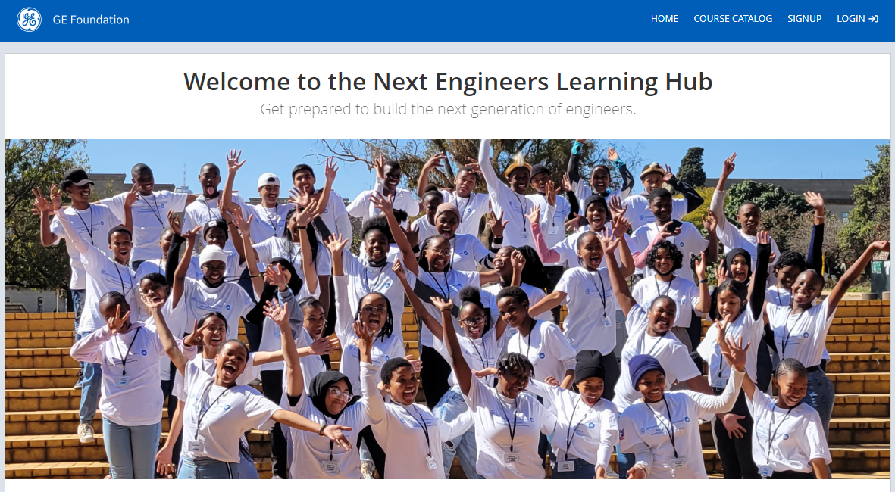
Table of Contents
Next Engineers eModules
Additional volunteer training opportunities.
Get Started
In addition to the live training sessions, we offer additional training modules you can complete on your own time. Click on the link below for instructions on how to access the eModules.
Emodules available
Safeguarding Program Participants
Next Engineers Orientation
Engineering Academy Overview
Facilitation 2.0: Enhancing Your Skills
Cultivating Authentic Relationships
To ENROLL
Go to our Learning Management System (LMS)
Create an account
Log in and “Join Group”
Enter Group Key: NextEng
Enjoy!
The LMS Self Registration Guide provides more detailed step-by-step instructions.

Slide 18
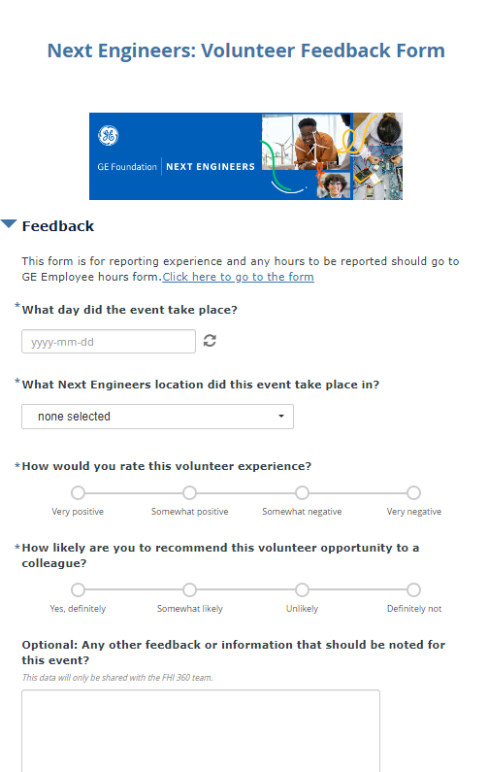

Table of Contents
Provide Feedback
Tell us about your experience!
Get Started
Next Engineers wants to make a meaningful impact and data collection is an important metric for assessing our impact, measuring our reach, and for making improvements. After every event, volunteers are asked to complete a rapid follow-up survey. It should take less than 2 minutes to complete! Community Partner staff may have paper copies of this form on-site, or you can click on the QR code below to access the form.

Slide 19
Table of Contents
Spread the Word
Share your success.
Get Started
Tell others about your volunteer work with Next Engineers through GE Yammer, GE City Teams channel, and other social media, such as Facebook, YouTube, Instagram, etc. On Instagram, make sure to follow and tag @NextEngineersGlobal. Consult your business communications team prior to creating social media posts to ensure compliance with GE policies. Want to share your message more broadly? Connect with our Communications Specialist.
Here’s HOW
Highlight your Next Engineers experiences, activities, events, and participant successes on your personal social media accounts.
Write an article or blog for LinkedIn.
Tweet about the event.
Share a photo on Facebook or Instagram.
Include Next Engineers under volunteer experiences on LinkedIn.
HASHTAGS
#NextEngineers
#GEFoundation
#GEProud
Be Sure to INCLUDE
Event Summary: Title of the event, location of event, who participated, what happened.
Photos: Add a photo of you and other volunteers at the event; tag your colleagues. If students or other individuals are in the photo, be sure you have obtained a signed consent form.
REMEMBER
All online media must comply with Company policies.
If using photos of students, talk with your program lead; a Consent and Photo Release form is required to ensure that there is no legal restriction to posting event photos and videos.

Slide 20
Volunteer Resources
Table of Contents
Get Started
NEXT ENGINEERS Website (NextEngineers.org) provides valuable information and resources for volunteers. Volunteers must create an account to access all resources.
STUDENT ACTIVITES. More than 50 interactive and fun, hands-on activities to use with Next Engineers students. Each activity includes a step-by-step guide with a list of the materials and estimated cost, facilitator checklist, and questions for how to engage youth with the topic discussed. Available activities include: Engineering Discovery Demonstrations Engineering Discovery Hands-On Activities Engineering Camp / Experience Activities Engineering Academy Engineering Design Challenges Engineering Academy College & Career Readiness Activities
VOLUNTEER eMODULES can be taken on your own time to review tips, best practices, and strategies for engaging with young people..
VOLUNTEER TIPS provide practical advice for first-time volunteers, as well as those who would like a refresher. Based on research and written by experts, these resources help volunteers prepare to engage and communicate effectively with young people. Volunteer Tips include: The Engineering Design Process Frequently Asked Student Questions Ten Guidelines for Building New Engineers What is engineering? Working With Youth: Facilitation Tips

Slide 21
Acknowledgements
The Next Engineers Volunteer Activation Kit was developed by FHI 360 with support from the GE Foundation to arm volunteers with the information needed to successfully plan and implement events to excite and ignite young people about engineering.
GE Foundation
The GE Foundation, an independent charitable organization funded by GE, is committed to transforming our communities and shaping the diverse workforce of tomorrow by leveraging the power of GE. Through Next Engineers, we are committed to increasing the diversity of young people in engineering. We are also inspiring others to act by connecting GE people with communities through our Matching Gifts Program and Disaster Relief. GE STAR awards provide financial support to children of eligible children of GE employees for their achievements.
About FHI 360
FHI 360 is a nonprofit human development organization dedicated to improving lives in lasting ways by advancing integrated, locally driven solutions. Our staff includes experts in health, education, nutrition, environment, economic development, civil society, gender, youth, research, technology, communication and social marketing — creating a unique mix of capabilities to address today’s interrelated development challenges. FHI 360 serves more than 70 countries and all U.S. states and territories.
FHI 360 staff members provide management support for Next Engineers and develop and disseminate essential resources. A separate team of FHI 360 researchers conducts the ongoing evaluation of Next Engineers activities.
Contact
NextEngineers@fhi360.org
Home

