Slide 1
Global Engineering Discovery Volunteer Quickstart Guide

Slide 2
Global Engineering Discovery
Volunteer Quickstart Guide
Are you ready to excite and ignite?
This guide highlights how GE employees worldwide can engage in Next Engineers through Engineering Discovery.* It is a quick resource to help you get started. For more detailed information, see the Global Engineering Discovery Volunteer Activation Kit.
Follow our 6 QUICK STEPS to volunteer with Global Engineering Discovery.
1
To use this Quickstart Guide and access the associated resources and links you MUST have an account with NextEngineers.org; click on the login button of the home page to create an account.
*If you are in Cincinnati, OH, Greenville, SC (USA), Johannesburg (SA), or Staffordshire (UK), please visit your location page on NextEngineers.org for more information about Next Engineers in your community.

Slide 3
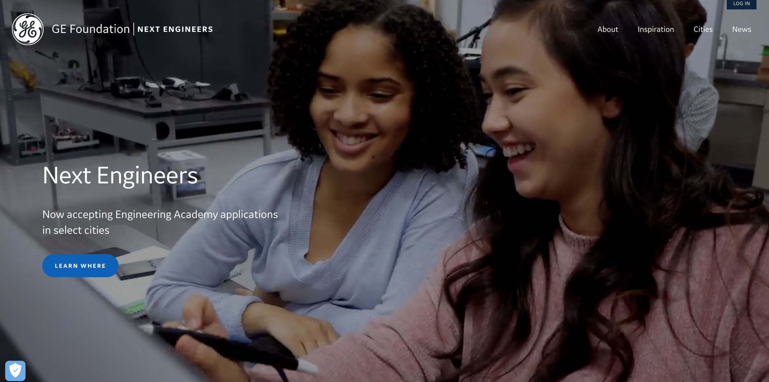
NextEngineers.org The Next Engineers website provides valuable information and resources for volunteers.
Tip!
You must create a Next Engineers website account to access the volunteer resources referenced and hyperlinked in this guide.
Follow these simple steps:
Go to NextEngineers.org
Click “LOG IN”
Choose “CREATE NEW ACCOUNT”
Log in and begin using the resources!

Slide 4
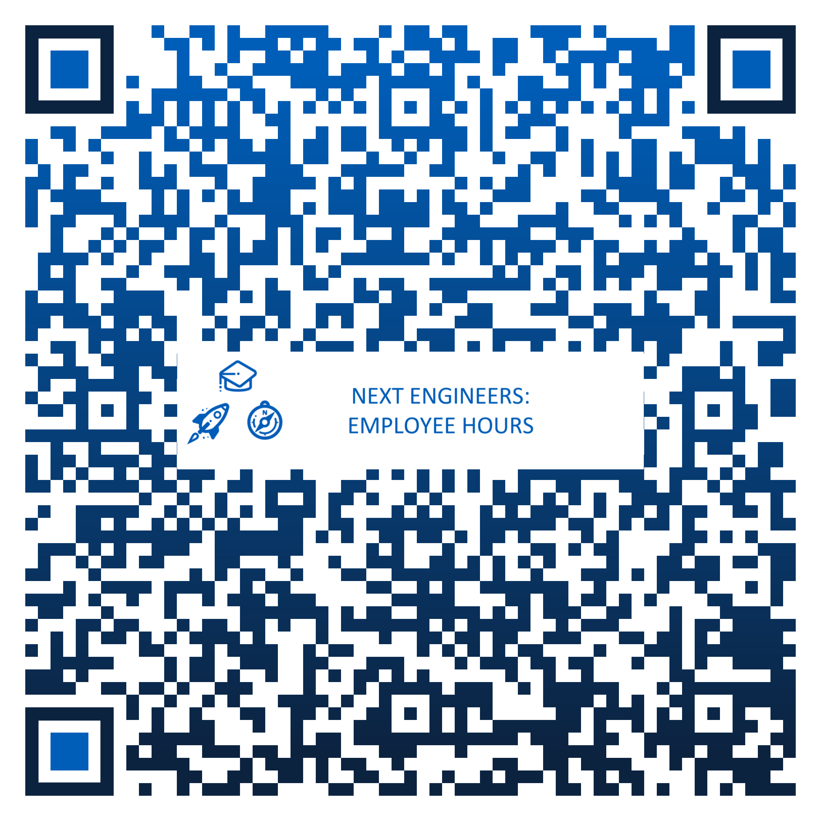
6 Quick Steps to Get Started Ready to get started? Follow these quick steps to volunteer with Engineering Discovery:
1
2
3
Get Ready
Get Connected
Get Set
Learn about Engineering Discovery and how you can volunteer
Contact potential schools/partners
Determine the event date/place/time, etc.
Participate in Volunteer Training
Finalize logistics with partners
PRACTICE!
4
5
6
Go!
Make it Count
Spread the Word
Arrive early with all supplies
Run the activity!
Share your successful event! #NextEngineers
Only share photos of students if parents were able to sign Consent Forms
Scan the QR code to report your Next Engineers activity

Slide 5
What is Engineering Discovery? How can I get involved?
Engineering Discovery provides opportunities for young people to explore and discover. Students (ages 13 to 14) around the globe build awareness about what engineers do through a variety of short, exploratory sessions led by GE volunteers. All GE employees can engage with Engineering Discovery! Volunteers share their story, show a demonstration, or deliver creative, hands-on activities in the classroom or community to inspire young people and expand their understanding of what engineering is all about. Learn More:
Share Your Story
Do a Demonstration
Lead a Hands-On Discovery Activity
1
VOLUNTEER
OPPORTUNITIES
2
3
3

Slide 6
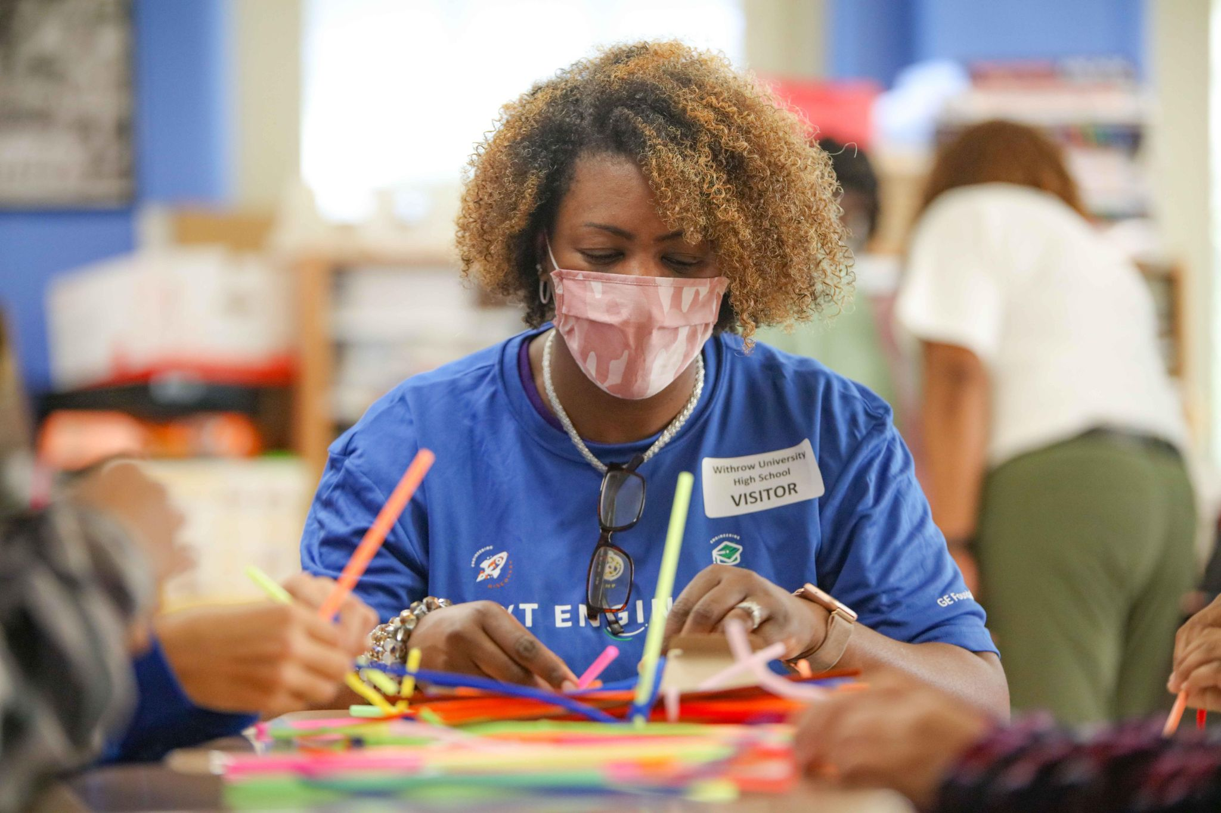
Before You Begin
Ask yourself:
WHAT? What type of Discovery activity or event are you most interested in? What do you want to do? What special skills or knowledge can you offer?
WHEN? When can you do it? How much time can you commit (thirty minutes, one hour, two hours)? When are you available (during work hours, after work, weekends)?
WHERE? Where will it take place? At a specific school? After school program? Community event? Virtually?
WHO? Who (principal, school director, teacher, other community member) do you need to engage to make it happen?
HOW? How many students are you looking to engage? What age? How many other volunteers will you need? How much will it cost? Do you have a budget?
1
2
3
3

Slide 7
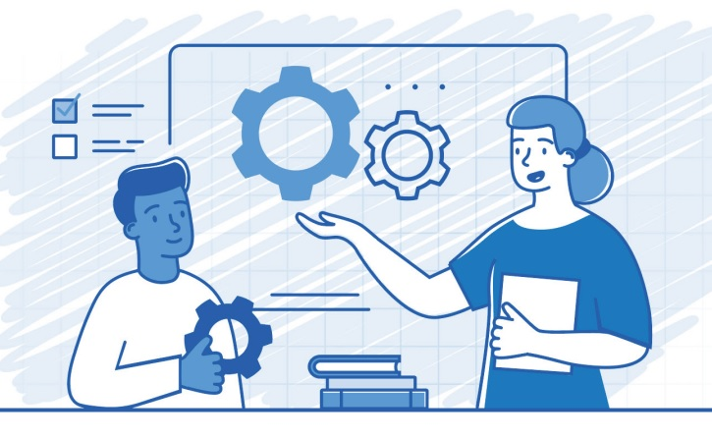
Share Your Story
INSPIRE YOUTH
Here’s How:
All GE employees can greatly enrich their time with young people by drawing on and sharing their own experiences and accomplishments in a relevant and personal way. This can be done in 10-30 minutes, depending on the event type and the timeframe allotted.
Speak at a school assembly as part of a Career Panel.
Serve as a Guest Speaker or give a Keynote Speech and share your career journey with students in an in-school or out-of-school setting.
Run an informational booth at a Career Fair and talk with youth about opportunities in engineering.
Write a Blog about your career and share it on your social media channels.
Create a Day in the Life Video Tour of your work environment.
You can also incorporate sharing your story into a Demonstration or Activity.
You don’t have to be an engineer! It’s helpful for young people to learn about all kinds of careers.

Slide 8
Do a Demonstration
EXCITE YOUTH
Here’s How:
Young people value experiences that engage them and encourage them to ask questions.
Demonstrations are short introductions to the endless opportunities in engineering. They are intended to be used at career fairs, science fairs, exhibits, any type of booth, or as an ice breaker activity.
Volunteers should choose a demo that aligns with their interests and knowledge and is most suitable to the students, the setting, and the timeframe. Demonstrations run 15-45 minutes. Make sure to practice beforehand!
Do a demonstration activity at a STEM Event hosted by the local community, library, science center, or museum.
Host an Engineering Event, such as Take Your Child to Work Day or other on-site event, with multiple activity stations featuring a variety of demonstration activities.
Facilitate a Virtual Demonstration for a classroom or a group of interested youth.

Slide 9
Lead a Hands-On Discovery Activity
Ignite YOUTH
Here’s How:
Hands-on Discovery activities give young people the opportunity to think and act like engineers through fun, interactive, team-based activities.
With your help, learners can build confidence in their abilities to engage with engineering principles and inquiry-based investigations, as well as to pursue further engineering endeavors.
Hands-on Engineering Discovery activities are ideal for classroom visits, afterschool programs, or virtual workshops. They can take 50 to 90 minutes to complete. Because they are more involved than Demonstrations and cover in-depth topics, volunteers need to dedicate time to plan and practice. Volunteers should choose activities with content that aligns with their background and knowledge and that are most suitable to the students, the setting, and the timeframe.
Visit a Secondary School Classroom (try a math, science, or technology class) and facilitate a Discovery activity.
Work with an After School Program/Club and offer a Discovery activity.
Host an Engineering Event at your GE facility and work with youth teams to complete a Discovery activity.

Slide 10
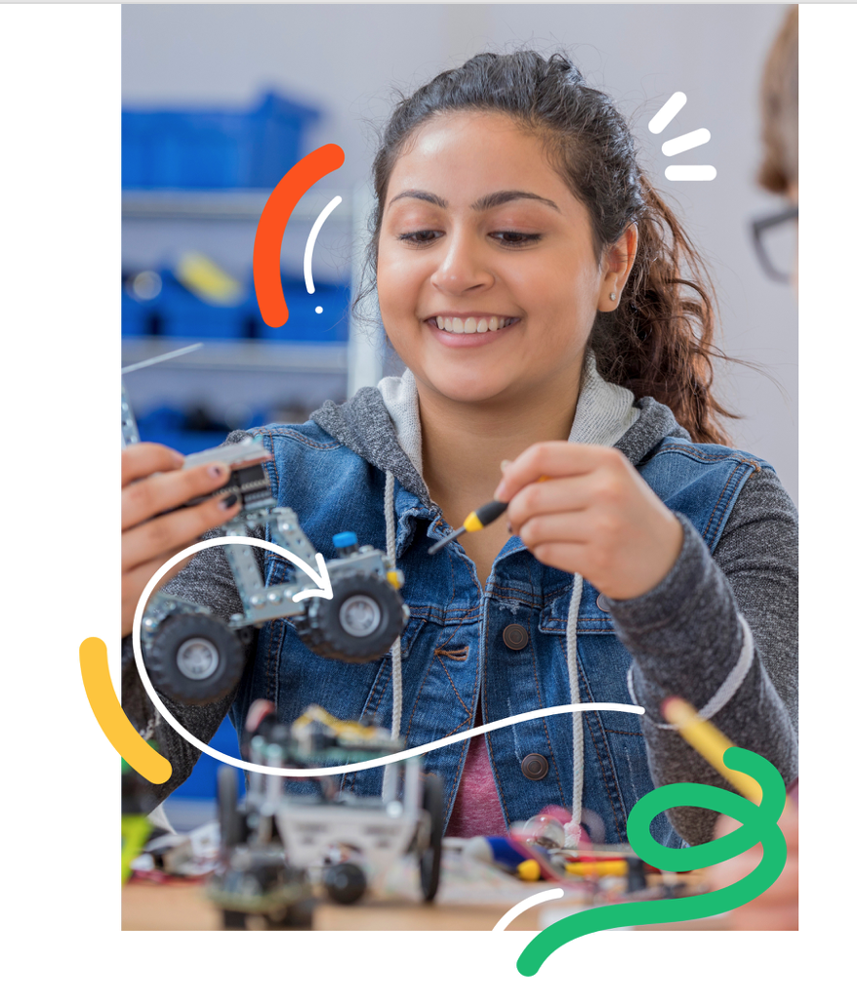
Get Prepared Resources to support you
Whatever Engineering Discovery opportunity you choose, an engaging, interactive, and fun session is no accident. It is the result of solid preparation, planning, and practice.
Our resources, trainings, and tips get you ready to implement Engineering Discovery:
NextEngineers.org – Find all Activity Guides and Tip Sheets under “Resources” after you log in.
Volunteer Tips – Including The Engineering Design Process, Frequently Asked Student Questions, Ten Guidelines for Building New Engineers, What is Engineering?, & Working With Youth: Facilitation Tips
Templates to help you share your story – Engineers and Others
Outreach & Engagement Materials – Under Resources, select Activity Type “Volunteer Engagement.”
Global Engineering Discovery Volunteer Activation Kit – Contains more detailed information about Next Engineers, Engineering Discovery, and the Volunteer Code of Conduct.
Global Engineering Discovery web page – This page is a great resource to share with colleagues and schools so they can learn more about Engineering Discovery in your community!

Slide 11
Acknowledgements The Next Engineers: Engineering Discovery Quickstart Guide was developed by FHI 360 to provide volunteers with the information needed to successfully plan and implement events to excite and ignite youth about engineering. GE Foundation The GE Foundation, an independent charitable organization funded by GE, is committed to transforming our communities and shaping the diverse workforce of tomorrow by leveraging the power of GE. Through Next Engineers, we are committed to increasing the diversity of young people in engineering. We are also inspiring others to act by connecting GE people with communities through our Matching Gifts Program and Disaster Relief. GE STAR awards provide financial support to children of eligible children of GE employees for their achievements. About FHI 360 FHI 360 is a global organization that mobilizes research, resources and relationships so people everywhere have access to the opportunities they need to lead full and healthy lives. With collaborations in over 60 countries, we work directly with local leaders to advance social and economic equity, improve health and well-being, respond to humanitarian crises and strengthen community resilience. We share data-driven insights and scalable tools that expand access and equity so communities can effectively address complex challenges, respond to shocks and achieve thriving futures. FHI 360 staff members provide management support for Next Engineers and develop and disseminate essential resources. A separate team of FHI 360 researchers conducts the ongoing evaluation of Next Engineers activities. Contact FHI 360 NextEngineers@fhi360.org

