Slide 1
Global Engineering Discovery
Volunteer Activation Kit

Slide 2

Welcome to Next Engineers
Welcome to Next Engineers
Engineers build worlds. All kinds of worlds. Worlds that haven’t even been thought of yet. Today’s youth are indispensable to building a world that works.
That’s why we created Next Engineers for the next generation of curious minds. We are committed to increasing the diversity of young people in engineering. Improving engineering awareness for youth (ages 13 to 14) and their guardians is key to the success of Next Engineers. This is our Engineering Discovery program.
Volunteers play a critical role in Engineering Discovery, and all GE employees can get involved. Your experiences and unique career journey can excite an interest in engineering and inspire youth to pursue further education and a career in engineering. Together, we can achieve our goals.
This Global Engineering Discovery Volunteer Activation Kit highlights how GE employees can engage in Next Engineers through Engineering Discovery. It is THE source for all that you need to know: how to get started, share your story, lead a student activity, and get the most out of your volunteering experience.
Follow our 6 QUICK STEPS to get started!
If you have any questions, reach out to FHI 360, the global implementing partner for Next Engineers, at NextEngineers@fhi360.org. We are here to support you!

Slide 3
6 Quick Steps
6 Quick Steps to Get Started
Ready to get involved? Follow these steps to volunteer with Engineering Discovery. Click on each step to navigate through the Activation Kit:
1
2
3
Get Informed
Learn about Next Engineers and the different ways you can volunteer with the Engineering Discovery program.
Get Ready
Develop a plan for how you implement an Engineering Discovery activity or event.
Get Set
Prepare and practice to ensure successful Engineering Discovery activity or event.
Volunteer Tip!
To use this Activation Kit, you MUST have an account with NextEngineers.org; click on the login button of the home page to create an account using your GE e-mail address.
4
5
6
Go
Excite. Ignite. Inspire!
Make it Count
Complete a rapid follow-up survey to help us assess the impact and measure the reach of Next Engineers.
Spread the Word
Share your success through internal GE channels and social media, such as LinkedIn and Instagram. Use hashtag #NextEngineers.

Slide 4

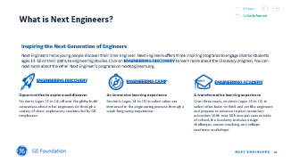
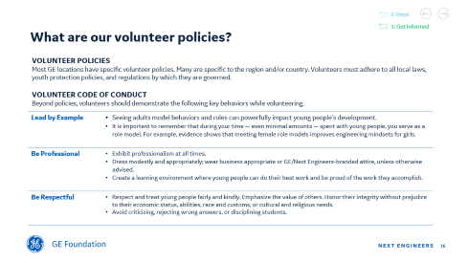
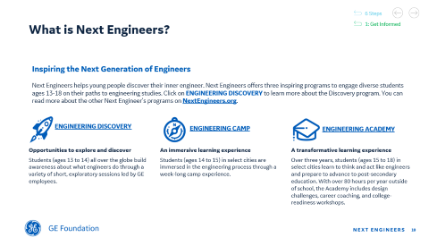
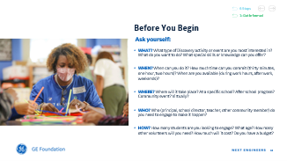
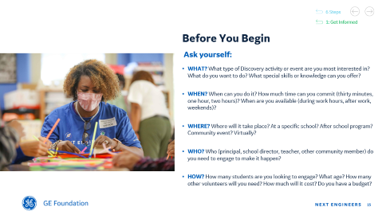
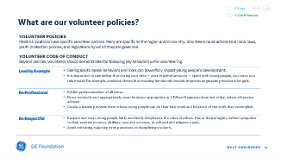
Step 1: Get Informed
6 Steps
1
Get Informed
Learn more about Next Engineers. Here’s how:
Click below for a short overview of Next Engineers and Engineering Discovery.
Next, click below for some key questions to think about before you start planning Engineering Discovery activities in your community.
Be sure to review the Volunteer Code of Conduct and be mindful of safeguarding procedures.

Slide 5
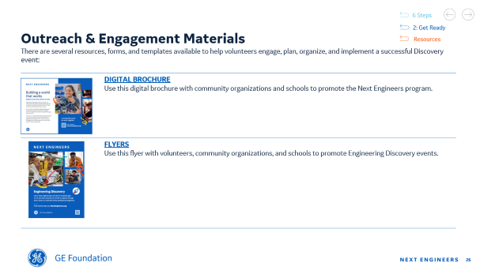
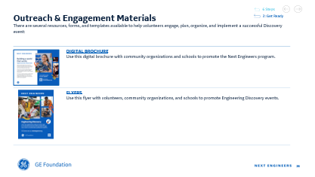
Step 2: Get Ready
6 Steps
2
Get Ready
Make a plan. Use the steps below to guide your thinking and click on the links for key resources.
Here’s HOW
Determine the type of ENGINEERING DISCOVERY activity to implement.
Identify a location. Consider your knowledge of the local community, schools, and organizations.
Contact the potential event location; send an email or talk with a site representative. In your ask, be sure to include what you want to do, the ideal timeframe, number of hours, target age(s), how may volunteers you will provide, etc.
Determine logistics:
    Location, date, allocated time, # of students
    Type of activity, agenda, and supplies, if needed
    room set-up, technology and internet access, etc.
    # of volunteers
REMEMBER
Block your calendar – note the date, time, and location.
Notify your supervisor if volunteering during working hours.
Click ON the Outreach & Engagement section below for school outreach templates, volunteer recruitment templates, and more!

Slide 6
Step 3: Get Set
6 Steps
3
Get Set
Prepare & practice.
Whichever Engineering Discovery opportunity you choose, an engaging, interactive, and fun session is no accident. It is the result of solid preparation and practice. Follow the steps below to ensure you are ready to work with youth.
Here’s HOW
Prepare to volunteer.
  Register and complete the self-paced eModules to learn tips, best practices, and strategies for engaging youth.
  Consider participating in a Volunteer Training Session.
  Review the Volunteer Tips and other tools that are available to help you succeed in this opportunity.
Prepare for the event. If conducting a Demonstration or Discovery Activity:
  Go to NextEngineers.org. Select an appropriate activity and download the facilitator guide.
  Obtain the required supplies and materials.
BE SURE TO
Practice! Practice! Practice!
  Make sure you understand the general activity structure, concepts, and themes.
  Do a trial run. Complete the calculations, experiment, etc.
  Be ready to discuss engineering careers and how they connect to the described activity.
Plan how you will Share Your Story in a relevant and personal way with youth; practice as needed.
REMEMBER
Customize the activity and tailor your remarks to reflect your background and experiences, as well as the cultural norms and language of the students in your community.

Slide 7
Step 4: Go
6 Steps
4
Go
Inspire, excite, and ignite youth.
Young people value experiences that engage them and encourage them to ask questions. Whether you are sharing your story, doing a demonstration, or leading a hands-on activity, you can spark their interest in engineering subjects. This may be the only exposure they get to engineering and professionals in the field. With your help, youth can build confidence in their abilities to engage with engineering principles, concepts, and inquiry-based investigations, opening the door to pursue further engineering endeavors.
Here’s HOW
Focus on the young people.
Give clear and logical instructions.
Be flexible. Change activities/set up if unforeseen things arise.
Use language, examples, and analogies that connect with young people.
Ask open-ended questions.
Listen actively.
Give the students a chance to ask questions.
Engage all students equally, especially the quiet ones.
Avoid criticizing, placing value, or rejecting wrong answers.
Help teams that may be struggling.
Take a break, if needed.
Be sure to
Arrive at least 30 minutes early.
Bring all required materials and supplies.
Set up the room appropriately for the activity.
Stay on top of the time so that everyone has a chance to participate.
REMEMBER
Be present.
Be yourself and make the activity your own.
Take photos and collect quotes that best showcase the event – only if Photo Consent Forms were completed.
Have fun!

Slide 8

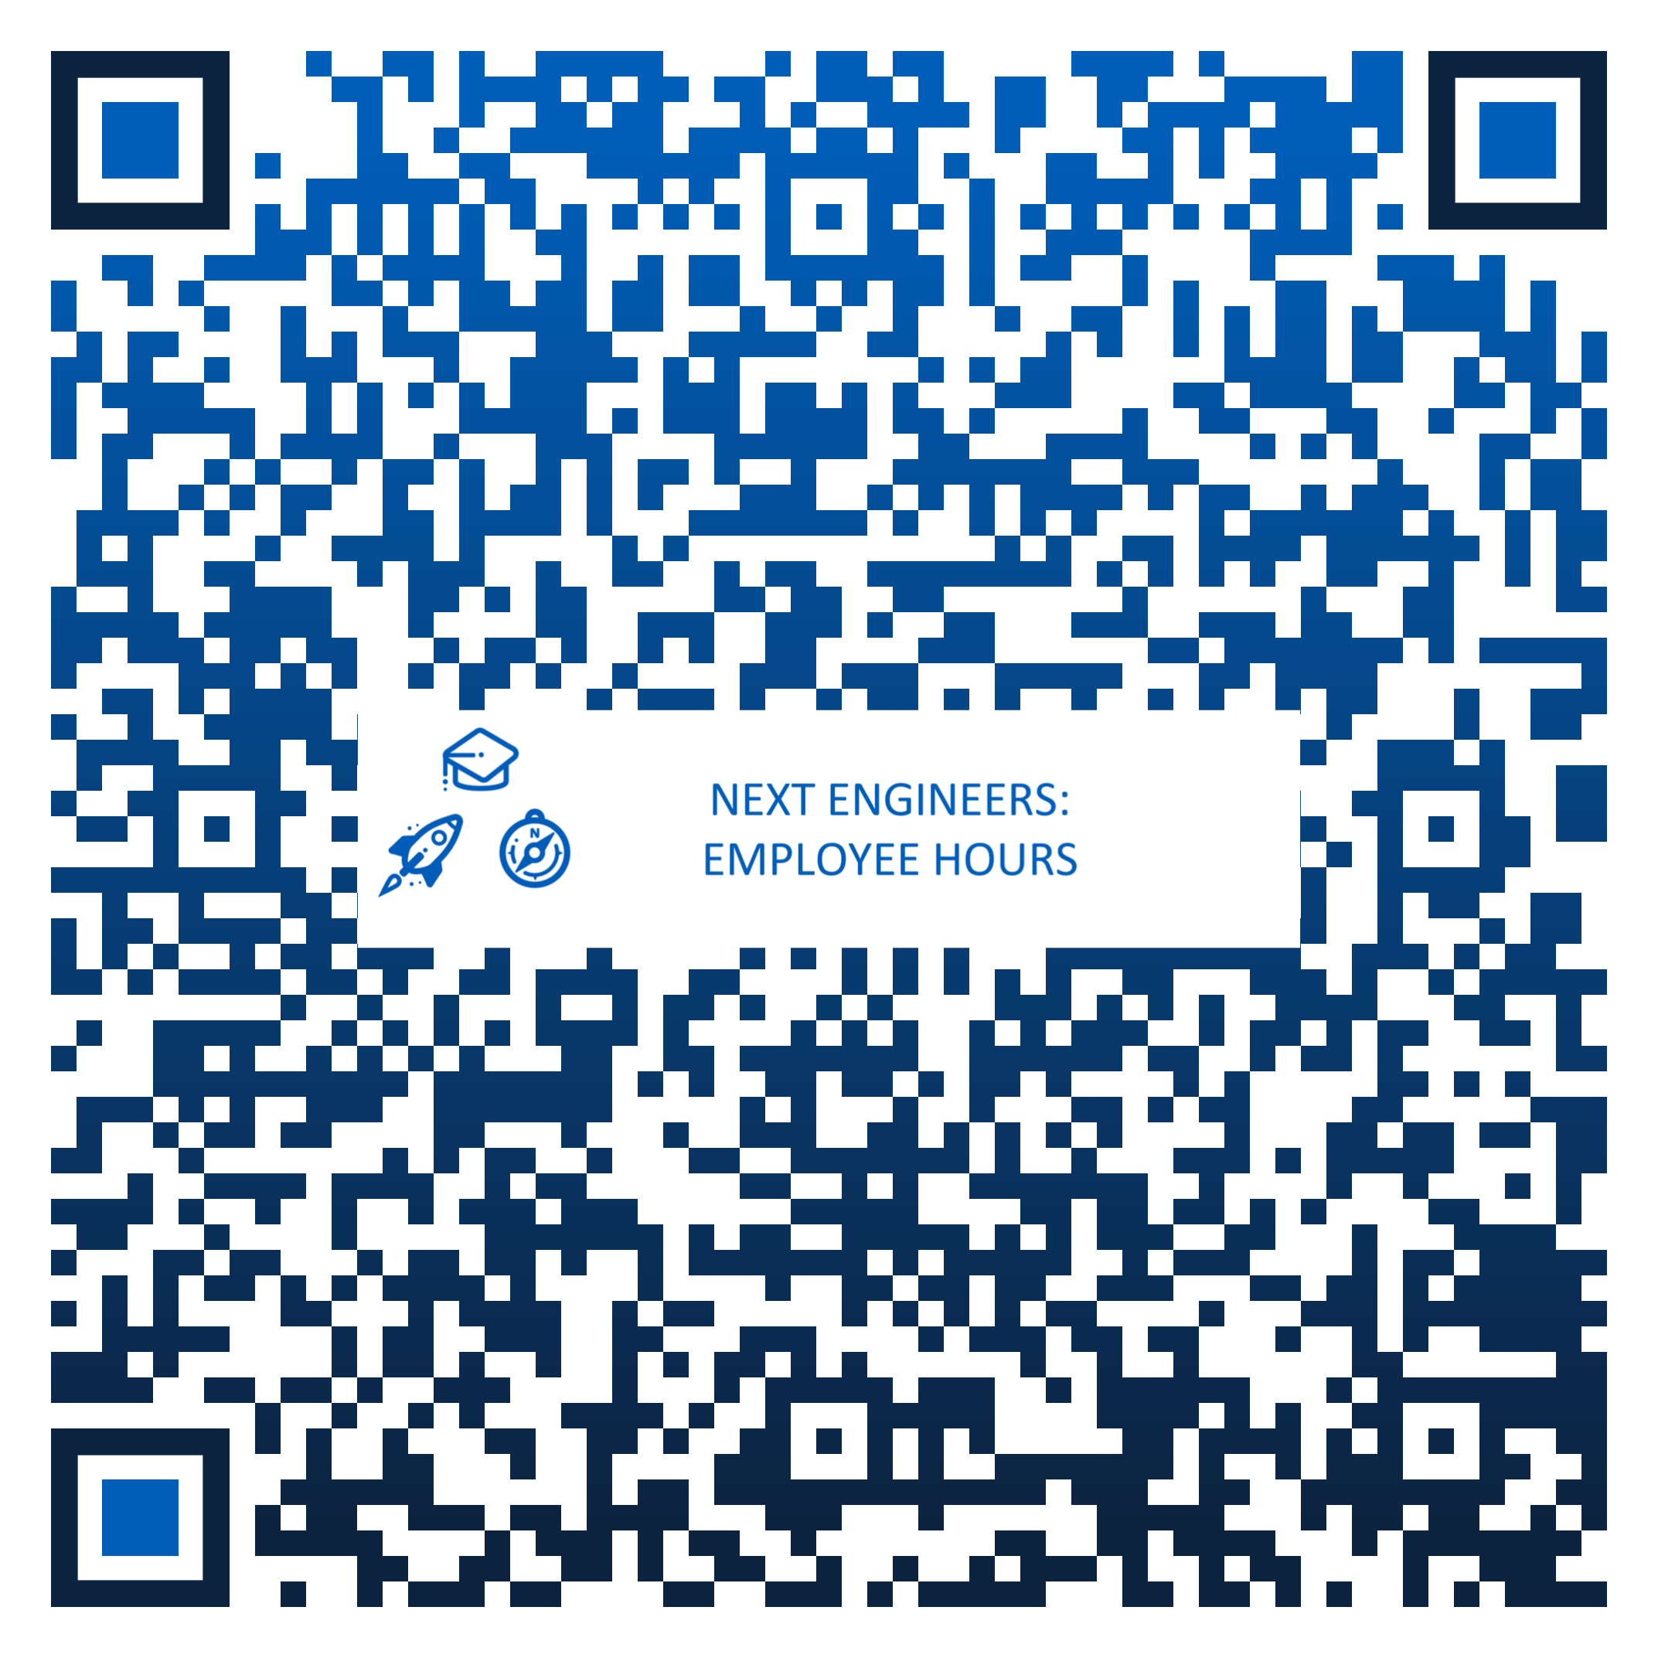
Step 5: Make It Count
6 Steps
5
Make It Count
Record the Engineering Discovery activity and give us your feedback! Here’s how:
Next Engineers wants to make a meaningful impact. Data collection is an important tool for assessing our impact, measuring our reach, and improving our resources. After every Discovery event, we ask that 2 forms are completed…
employee hours form
One volunteer should submit this form to report the Engineering Discovery activity. Prepare to report:
Date of event
Number of youth, approximate number who attended a previous activity, and approximate number of female youth
Number of parents/guardians
Number of volunteers and approximate number of volunteering hours
Scan the QR Code or click on the image
to access the Employee Hours form.
VOLUNTEER FEEDBACK FORM
All volunteers are encouraged to share feedback on their volunteer experiences by submitting a feedback form after each activity. The survey should take less than 2 minutes to complete!
Scan the QR Code or click on the image
to access the Volunteer Feedback form.

Slide 9
Step 6: Spread the Word
6 Steps
6
Spread the Word
Share your volunteering efforts.
Tell others about your Engineering Discovery volunteer work with the Next Engineers community internally at GE and through social media, such as Instagram, LinkedIn, blogs, etc. Consult your business communications team prior to creating social media posts to ensure compliance with GE policies. Want to share your message more broadly? Connect with our Communications Specialist.
Here’s HOW
Write an article or blog for LinkedIn.
Tweet about the event.
Share a photo on Facebook or Instagram.
Include Next Engineers under your volunteer experiences on LinkedIn.
Highlight your Next Engineers experiences, activities, events, and participant successes on your personal social media accounts.
HASHTAGS
#NextEngineers
Be Sure to INCLUDE
Event Summary: Title of the event, location of event, who participated, what happened.
Photos: Add a photo of you and other volunteers at the event; tag your colleagues. If students or other individuals are in the photo, be sure you have obtained a signed consent form.
REMEMBER
All online media must comply with Company policies.
If using photos of youth, a Consent and Photo Release form is required to ensure that there is no legal restriction to posting event photos and videos.

Slide 10




What is Next Engineers?
6 Steps
1: Get Informed
Inspiring the Next Generation of Engineers
Next Engineers helps young people discover their inner engineer. Next Engineers offers three inspiring programs to engage diverse students ages 13-18 on their paths to engineering studies. Click on Engineering Discovery to learn more about the Discovery program. You can read more about the other Next Engineer’s programs on NextEngineers.org.
Engineering Discovery
Engineering Camp
Engineering Academy
Opportunities to explore and discover
Students (ages 13 to 14) all over the globe build awareness about what engineers do through a variety of short, exploratory sessions led by GE employees.
An immersive learning experience
Students (ages 14 to 15) in select cities are immersed in the engineering process through a week-long camp experience.
A transformative learning experience
Over three years, students (ages 15 to 18) in select cities learn to think and act like engineers and prepare to advance to post-secondary education. With over 80 hours per year outside of school, the Academy includes design challenges, career coaching, and college-readiness workshops.

Slide 11


What is Engineering Discovery?
How can I get involved?
6 Steps
1: Get Informed
2: Get Ready
Engineering Discovery provides opportunities for young people to explore and discover. Students (ages 13 to 14) around the globe build awareness about what engineers do through a variety of short, exploratory sessions led by GE volunteers. Engineering Discovery activities are meant to inspire young people and expand their understanding of what engineering is all about. Volunteers can participate in Engineering Discovery in three unique ways. Click on the titles below for more!
Share Your Story
Do a Demonstration
Lead a Hands-On Discovery Activity
1
VOLUNTEER
OPPORTUNITIES
2
3
3

Slide 12



Share Your Story
6 Steps
Share Your Story
Discovery Overview
INSPIRE YOUTH
Here’s How:
Volunteers can greatly enrich their time with young people by drawing on and sharing their own experiences and accomplishments. You can share your story and spotlight various engineering careers through in-person interactions with youth, through videos, or through other social media communication. This can be done in 10-30 minutes, depending on the event type and the timeframe allotted.
Speak at a school assembly as part of a Career Panel.
Serve as a Guest Speaker or give a Keynote Speech and share your career journey with students in an in-school or out-of-school setting.
Run an informational booth at a Career Fair and talk with youth about opportunities in engineering.
Write a Blog about your career and share it on your social media channels.
Create a Day in the Life Video Tour of your work environment.
You can also incorporate sharing your story into a Demonstration or Hands-On Activity.
You don’t have to be an engineer! It’s helpful for young people to learn about all kinds of careers.
VOLUNTEER TIP!
See the VOLUNTEER RESOURCES section for links to Share Your Story guides.

Slide 13

Do a Demonstration
6 Steps
Do a Demonstration
Discovery Overview
EXCITE YOUTH
Here’s How:
Youth value experiences that engage them and encourage them to ask questions.
Demonstrations are short introductions to the endless opportunities in engineering. They are intended to be used at career fairs, science fairs, exhibits, any type of booth, or as an ice breaker activity.
Volunteers should choose a demo that aligns with their interests and knowledge and is most suitable to the students, the setting, and the timeframe. Demonstrations run 15-45 minutes. Make sure to practice beforehand!
Do a demonstration activity at a STEM Event hosted by the local community, library, science center, or museum.
Host an Engineering Event, such as Take Your Child to Work Day or other on-site event, with multiple stations featuring different demonstrations.
Facilitate a Virtual Demonstration for a classroom or a group of interested youth.
VOLUNTEER TIP!
Volunteers do not need to develop content for these interactions. See the VOLUNTEER RESOURCES section for links to Demonstration activities and facilitator guides.

Slide 14

Lead a Discovery Activity
6 Steps
Lead a Hands-On Activity
Discovery Overview
Ignite YOUTH
Here’s How:
Hands-on activities give youth the opportunity to think and act like engineers through fun, team-based activities.
With your help, youth can build confidence in their abilities to engage with engineering principles and inquiry-based investigations, as well as to pursue further engineering endeavors.
Hands-on activities are ideal for classroom visits, afterschool programs, or virtual workshops. They can take 50 to 90 minutes to complete. Because they are more involved than Demonstrations and cover in-depth topics, volunteers need to dedicate time to plan and practice. Volunteers should choose activities with content that aligns with their background and knowledge and is most suitable to the students, the setting, and the timeframe.
Visit a Secondary School Classroom (try a math, science, or technology class) and facilitate a Discovery activity.
Work with an After School Program/Club and offer a Discovery activity.
Host an Engineering Event at the GE facility and work with youth teams to complete a Discovery activity.
VOLUNTEER TIP!
Volunteers do not need to develop content for these interactions. See the VOLUNTEER RESOURCES section for links to Discovery Activities and facilitator guides.

Slide 15
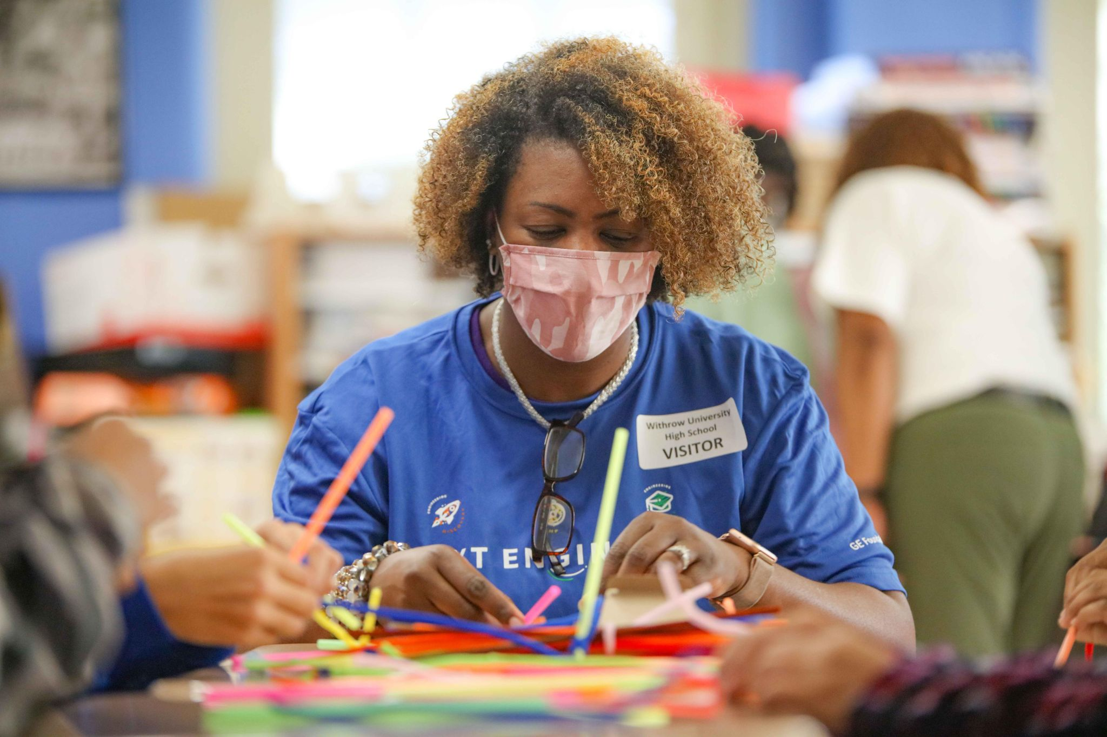
Before You Begin
6 Steps
Before You Begin
1: Get Informed
Ask yourself:
WHAT? What type of Discovery activity or event are you most interested in? What do you want to do? What special skills or knowledge can you offer?
WHEN? When can you do it? How much time can you commit (thirty minutes, one hour, two hours)? When are you available (during work hours, after work, weekends)?
WHERE? Where will it take place? At a specific school? After school program? Community event? Virtually?
WHO? Who (principal, school director, teacher, other community member) do you need to engage to make it happen?
HOW? How many students are you looking to engage? What age? How many other volunteers will you need? How much will it cost? Do you have a budget?
1
2
3
3

Slide 16
What are our volunteer policies?
6 Steps
1: Get Informed
Volunteer POLICIES
Most GE locations have specific volunteer policies. Many are specific to the region and/or country. Volunteers must adhere to all local laws, youth protection policies, and regulations by which they are governed.
Volunteer code of conduct
Beyond policies, volunteers should demonstrate the following key behaviors while volunteering.
Lead by Example | Seeing adults model behaviors and roles can powerfully impact young people's development. It is important to remember that during your time — even minimal amounts — spent with young people, you serve as a role model. For example, evidence shows that meeting female role models improves engineering mindsets for girls.
Be Professional | Exhibit professionalism at all times. Dress modestly and appropriately; wear business appropriate or GE/Next Engineers-branded attire, unless otherwise advised. Create a learning environment where young people can do their best work and be proud of the work they accomplish.
Be Respectful | Respect and treat young people fairly and kindly. Emphasize the value of others. Honor their integrity without prejudice to their economic status, abilities, race and customs, or cultural and religious needs. Avoid criticizing, rejecting wrong answers, or disciplining students.

Slide 17
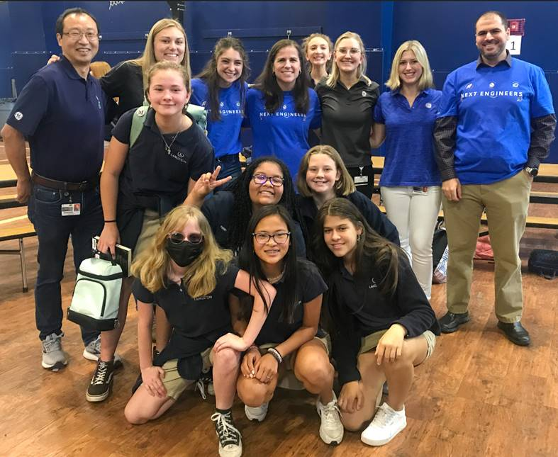
Volunteer Code of Conduct: part 2
6 Steps
1: Get Informed
Be Responsible | Be punctual for your voluntary duties. If you sign up, show up! If unable to attend, inform the Volunteer Team Lead as early as possible. Clean up; leave the space better than you found it.
Be Relatable | Young people have unique social, personal, and academic needs. Approach them with sincerity and respect.
Be Present | Put away cell phones, tablets, and other technology. Strive to actively listen to and engage all young people.
Be Discerning | Behave in the most appropriate or desirable manner during the activities that will not create liability or bring GE into disrepute. Ensure the safety of all participants. Do not hesitate to speak up or act in the interest of safety. Report any safety concerns or unsafe behavior to Next Engineers' global implementing partner, FHI 360, at NextEngineers@fhi360.org Exercise judgement. Do not offer to help young people beyond the Engineering Discovery engagement.

Slide 18
What are our safeguarding procedures?
6 Steps
1: Get Informed
Safeguarding procedures
When interacting with youth, volunteers should be aware of safeguarding procedures – designed to protect youth and volunteers! It is highly recommended that you take the 15–20-minute, SAFEGUARDING PROGRAM PARTICIPANTS eMODULE prior to volunteering.
Be Mindful | Be mindful of: Your intentions when communicating and working with youth (< 18 years old). How your interactions might be perceived or could create a pattern. Treating all youth equitably (e.g., expressive participants vs. quiet participants). Our good intentions can put adults and youth in situations to be misinterpreted Do not give favors or special treatment to youth (if there are incentives for participation, all participants and adults should be aware). Refrain from providing individual coffee, snacks, gifts, etc. Do not be alone with youth (this extends to email communication: copy adults from the Community Partner Organization, teachers, or parents, as applicable). Do not take photographs of youth unless you have the express written consent from the program. Do not socialize with youth beyond professional work environments. Report any suspected or known harm towards Next Engineers participants directly to FHI 360, using one of the two options: 1) Next Engineers Staff : NextEngineers@fhi360.org or 2) FHI 360 Office of Compliance & Internal Audit (OCIA): Compliance@fhi360.org or OCIA Hotline: (800) 461-9330 (TOLL-FREE inside U.S.) or +1-720-514-4400 (International Collect).

Slide 19
Volunteer Resources
6 Steps
Discovery Overview
Volunteer Resources
Our resources, trainings, and tips get you ready for your volunteer experience. Click on a link below for more information.
NextEngineers.org
Volunteer Training Opportunities
Volunteer Tips
Share Your Story
Student Activities
Outreach & Engagement Materials

Slide 20
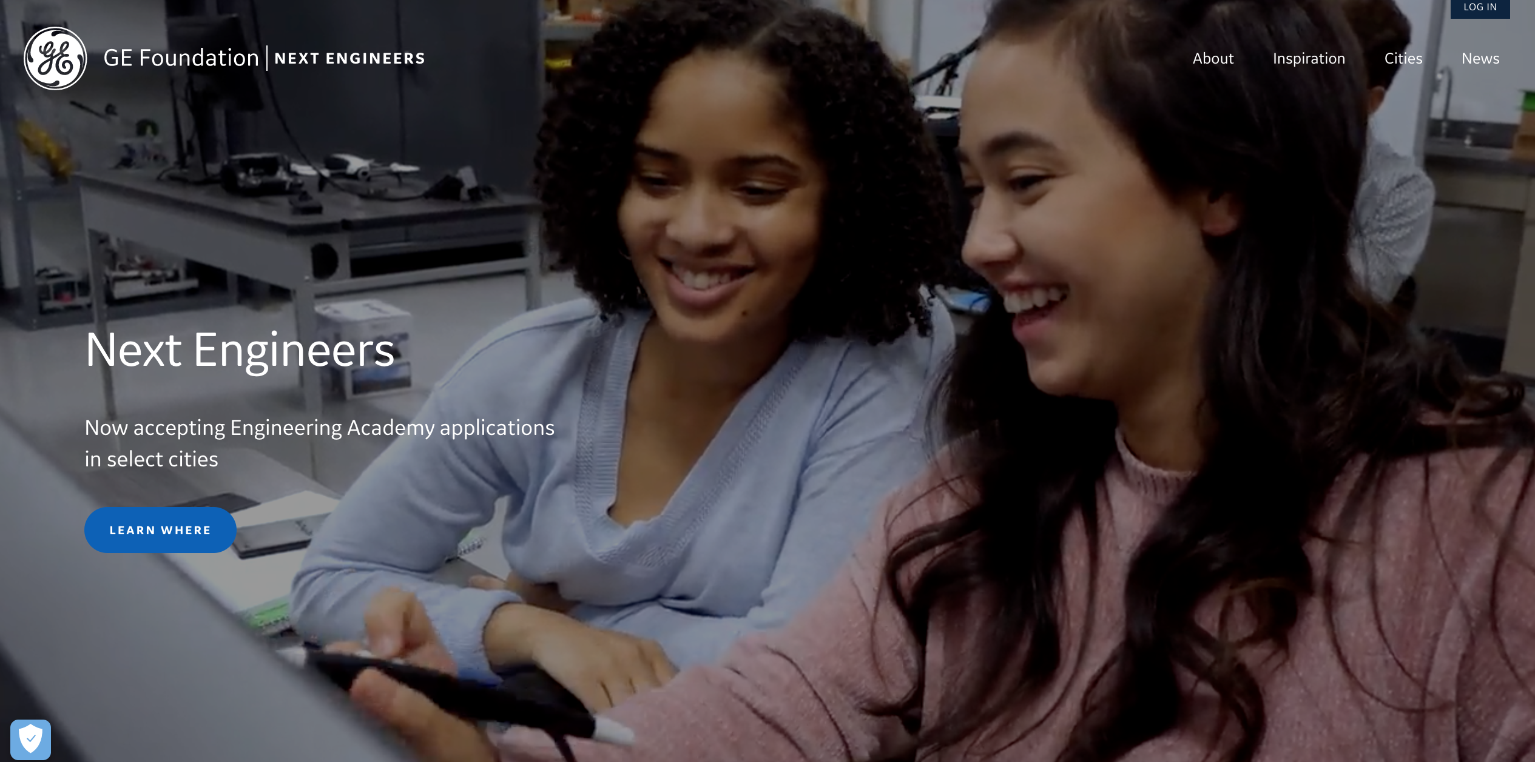
NextEngineers.org
The Next Engineers website provides valuable information and resources for volunteers.
6 Steps
Resources
Tip!
You must create a Next Engineers website account to access the volunteer resources referenced and hyperlinked in this guide.
Follow these simple steps:
Go to NextEngineers.org
Click “LOG IN”
Choose “CREATE NEW ACCOUNT”
Log in and begin using the resources!

Slide 21

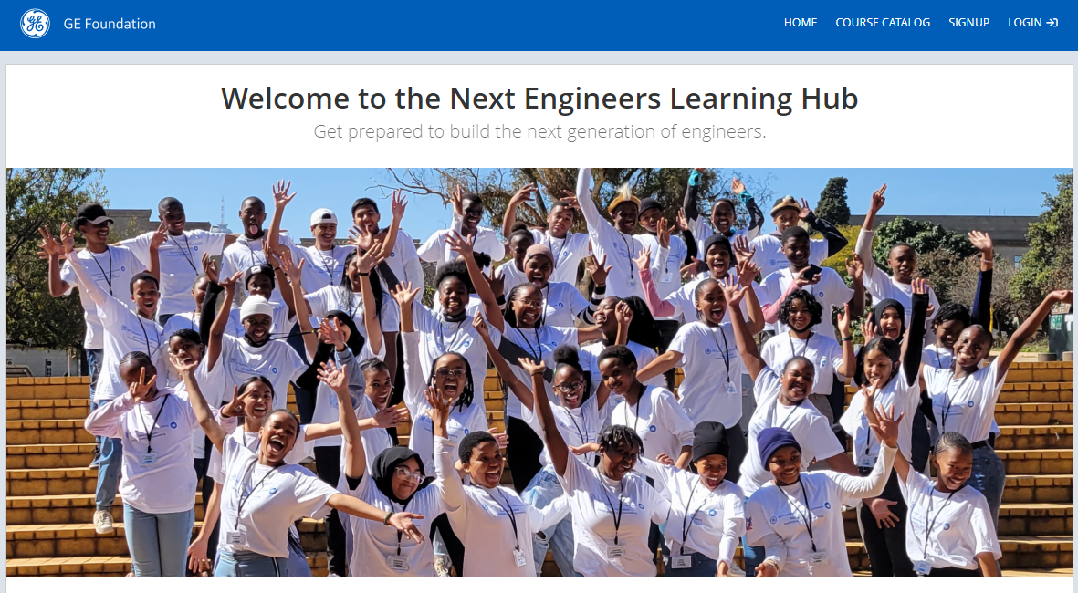
6 Steps
3: Get Set
Volunteer Training: Next Engineers eModules
Resources
We offer training modules you can complete on your own time so you can feel confident engaging with youth. Click on the link below for instructions on how to access the eModules.
emodules available
Safeguarding Program Participants
Next Engineers Orientation
Facilitation 2.0: Enhancing Your Skills
Cultivating Authentic Relationships
To ENROLL
Go to our Learning Management System (LMS)
Create an account
Log in and “Join Group”
Enter Group Key: NextEng
Enjoy!
The LMS Self Registration Guide provides more detailed step-by-step instructions.

Slide 22


Volunteer Training: Additional Opportunities
Volunteers can obtain practical advice for implementing Next Engineers activities and working with youth.
6 Steps
3: Get Set
Resources
 | VIRTUAL WORKSHOPS AND Q&A SESSIONS FHI 360 will host a series of Virtual Workshops and Q&A Sessions for volunteers. These are designed to further support and provide guidance to employees looking to implement Global Engineering Discovery activities. Check your e-mail for invitations from GE Aerospace!
 | HOW-TO VIDEOS These “fast-walk” videos of Discovery Activities are designed to help volunteers feel confident and comfortable facilitating activities and interacting with youth. Go to the RESOURCES section of the Next Engineers website and select a Discovery Activity; play the video, if available.

Slide 23
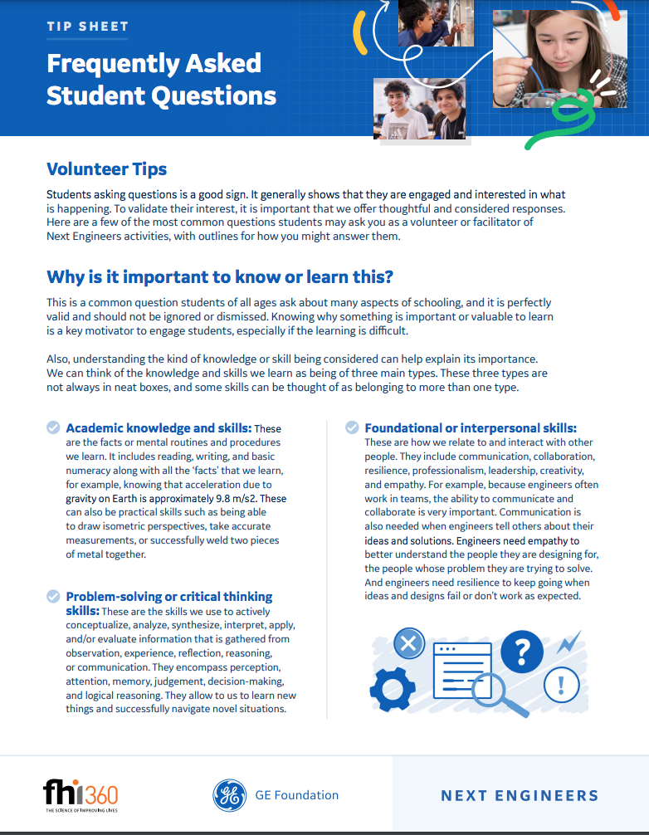
Volunteer Tips
Practical advice, information, and data for volunteers.
6 Steps
3: Get Set
Resources
 | VOLUNTEER TIPS provide practical advice for first-time volunteers, as well as those who would like a refresher. Based on research and written by experts, these resources will help you prepare to engage youth, communicate effectively with young people, and facilitate groups of students. Tips targeting specific concepts, such as developing an engineering mindset, are written by experts in the field and provide you with a broader base of knowledge. Volunteer Tips include: The Engineering Design Process Frequently Asked Student Questions Ten Guidelines for Building New Engineers What is engineering? Working With Youth: Facilitation Tips

Slide 24
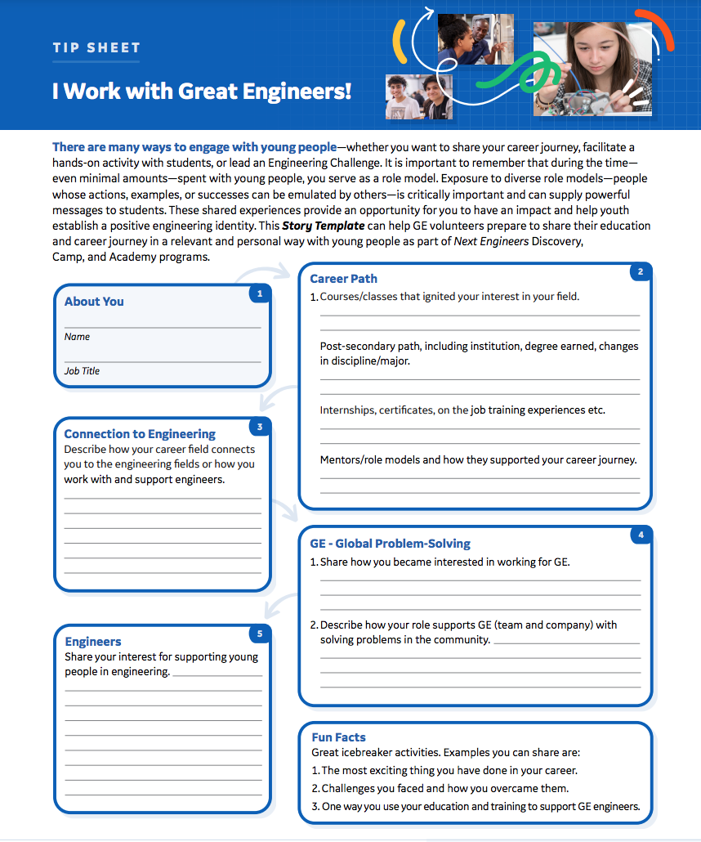

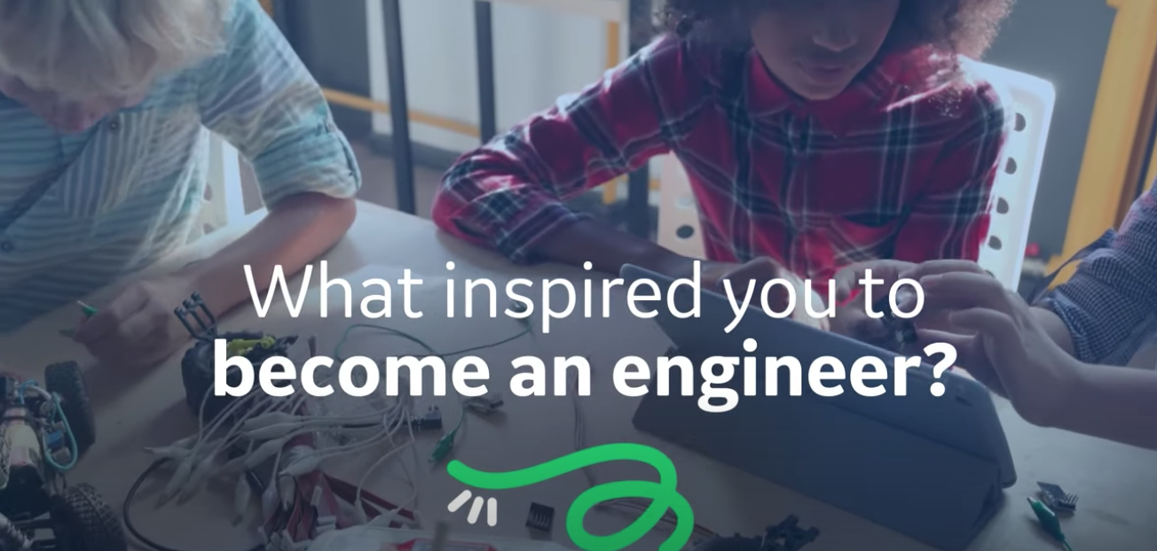
Share Your Story
All volunteers can greatly enrich their time with young people by drawing on and sharing their own experiences and accomplishments in a relevant and personal way. There are several resources available to help you:
6 Steps
3: Get Set
Resources
 | SHARE MY STORY FORM helps volunteers prepare to talk about engineering interests, education, and career path. Available forms include: I’m an Engineer! Storytelling Worksheet I Work with Great Engineers! Storytelling Worksheet
 | ENGINEERING AT WORK VIDEOS Find out what drives a variety of engineering professionals, each with a unique story to tell. From pushing the envelope of flight and reimagining the jet engine to creating tomorrow’s energy, learn what sparked their interest in engineering and what they're working on today.
 | MyAhaMoment Building a better world doesn’t happen overnight—it all begins with an Aha! moment. Hear the stories of GE engineers and what inspires them to build a better world.

Slide 25


Student Activities
Whether you are looking for a demonstration, a short activity, or a longer activity to use during a workshop, Next Engineers has got you covered.
6 Steps
Resources
 | DEMONSTRATIONS These short, introductory hands-on demonstration activities introduce students to engineering. The 20+ demonstrations are intended for use at career fairs, science fairs, exhibits, any type of booth, or as ice breakers. Each Demonstration Activity includes a step-by-step guide with a list of the materials and estimated cost, facilitator checklist, and suggestions for how to engage youth with the topic discussed. Volunteers should choose an activity that aligns with their interests and knowledge and is most suitable to the students, the setting, and the timeframe.
 | HANDS-ON ACTIVITIES More than 30 interactive and fun hands-on activities for secondary school students, ages 13-18; activities range from about 60 minutes to up to two hours in length and focus on one or more engineering concepts and careers. Each Discovery Activity includes a step-by-step guide with a list of the materials and estimated cost, facilitator checklist, and notations for how to engage youth with the topic discussed. Volunteers should choose an activity that aligns with their interests and knowledge and is most suitable to the students, the setting, and the timeframe.

Slide 26


Outreach & Engagement Materials
There are several resources, forms, and templates available to help volunteers engage, plan, organize, and implement a successful Discovery event:
6 Steps
2: Get Ready
Resources
 | DIGITAL BROCHURE Use this digital brochure with community organizations and schools to promote the Next Engineers program.
 | FLYERS Use this flyer with volunteers, community organizations, and schools to promote Engineering Discovery events.

Slide 27
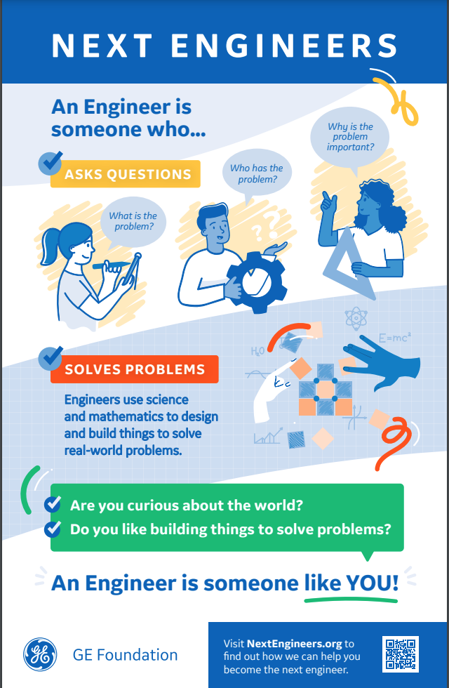
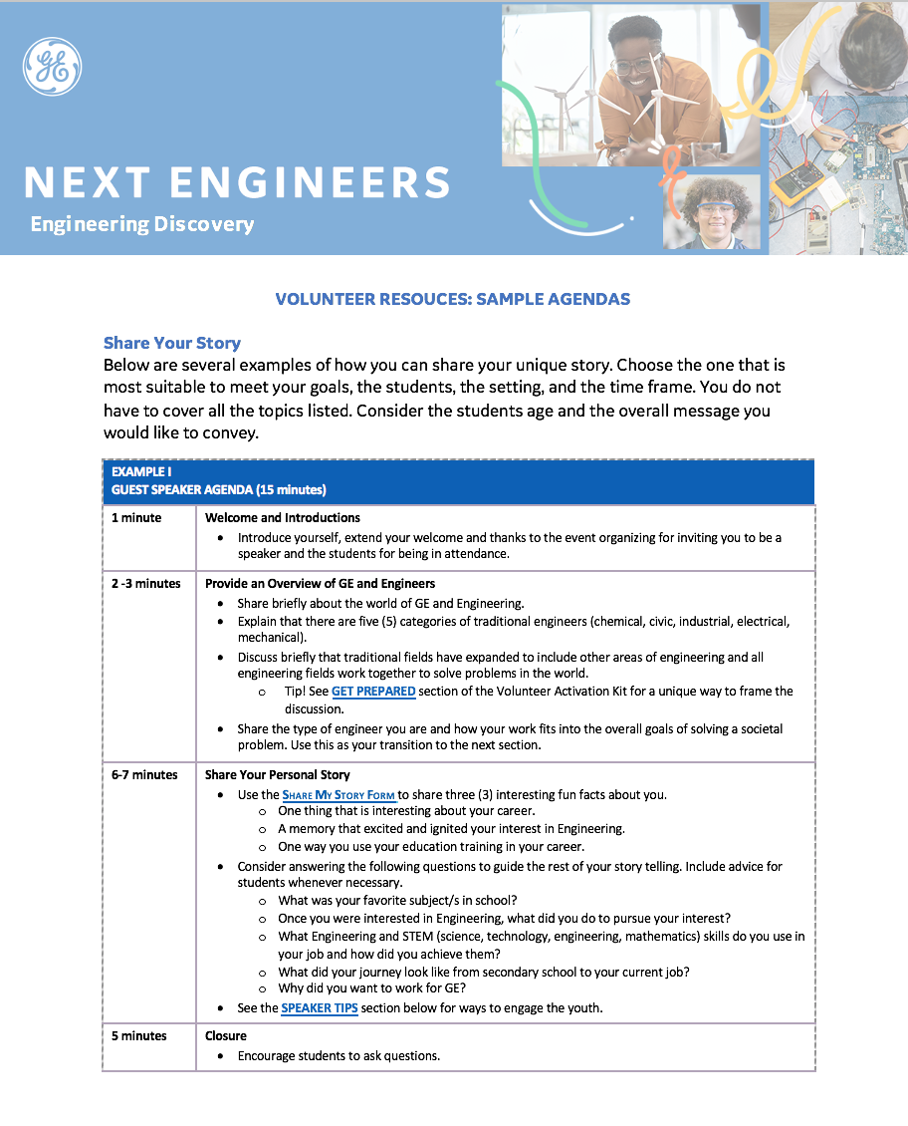
Outreach and Engagement materials part 2
6 Steps
2: Get Ready
Resources
 | POSTER Share this poster with schools and community organizations. It is a great leave-behind that can ignite and excite long after the Discovery event.
 | BRANDING KIT: COMMUNICATIONS ASSETS, FORMS & TEMPLATES Listed below are examples of customizable forms and templates included in the kit. Instead of purchasing Next Engineers shirts, volunteers should wear newly branded GE Aerospace volunteer t-shirts that are to be worn for volunteer events. If you are ordering swag, please first e-mail Next Engineers Communication Specialist for design approval. Next Engineers Logos and Icons Sample Introductory School Emails Sample Volunteer Recruitment Materials Calendar templates Photos, and more!

Slide 28
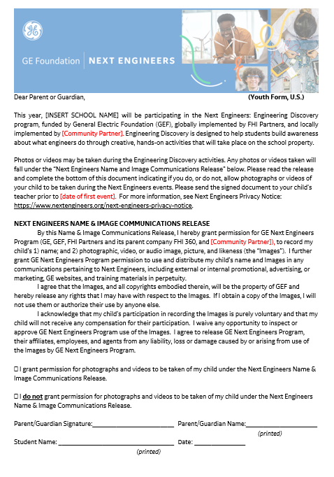
Outreach and Engagement materials part 2
6 Steps
2: Get Ready
6: Spread the Word
Resources
 | PHOTO RELEASE FORMS Before you share any photos or videos publicly, make sure participants have submitted a photo & video release form.

Slide 29
Acknowledgements
Home
The Global Engineering Discovery Volunteer Activation Kit was developed by FHI 360 with support from the GE Foundation to support volunteers with the information needed to successfully plan and implement events to excite and ignite youth about engineering.
GE Foundation
The GE Foundation, an independent charitable organization funded by GE, is committed to transforming our communities and shaping the diverse workforce of tomorrow by leveraging the power of GE. Through Next Engineers, we are committed to increasing the diversity of young people in engineering. We are also inspiring others to act by connecting GE people with communities through our Matching Gifts Program and Disaster Relief. GE STAR awards provide financial support to children of eligible children of GE employees for their achievements.
About FHI 360
FHI 360 is a nonprofit human development organization dedicated to improving lives in lasting ways by advancing integrated, locally driven solutions. Our staff includes experts in health, education, nutrition, environment, economic development, civil society, gender, youth, research, technology, communication, and social marketing — creating a unique mix of capabilities to address today’s interrelated development challenges. FHI 360 serves more than 70 countries and all U.S. states and territories.
FHI 360 staff members provide management support for Next Engineers and develop and disseminate essential resources. A separate team of FHI 360 researchers conducts the ongoing evaluation of Next Engineers activities.
Contact
NextEngineers@ge.com

