Slide 1
2025 Next Engineers Partners' Workshop:
Building a Better Project
Selected slides

Slide 2
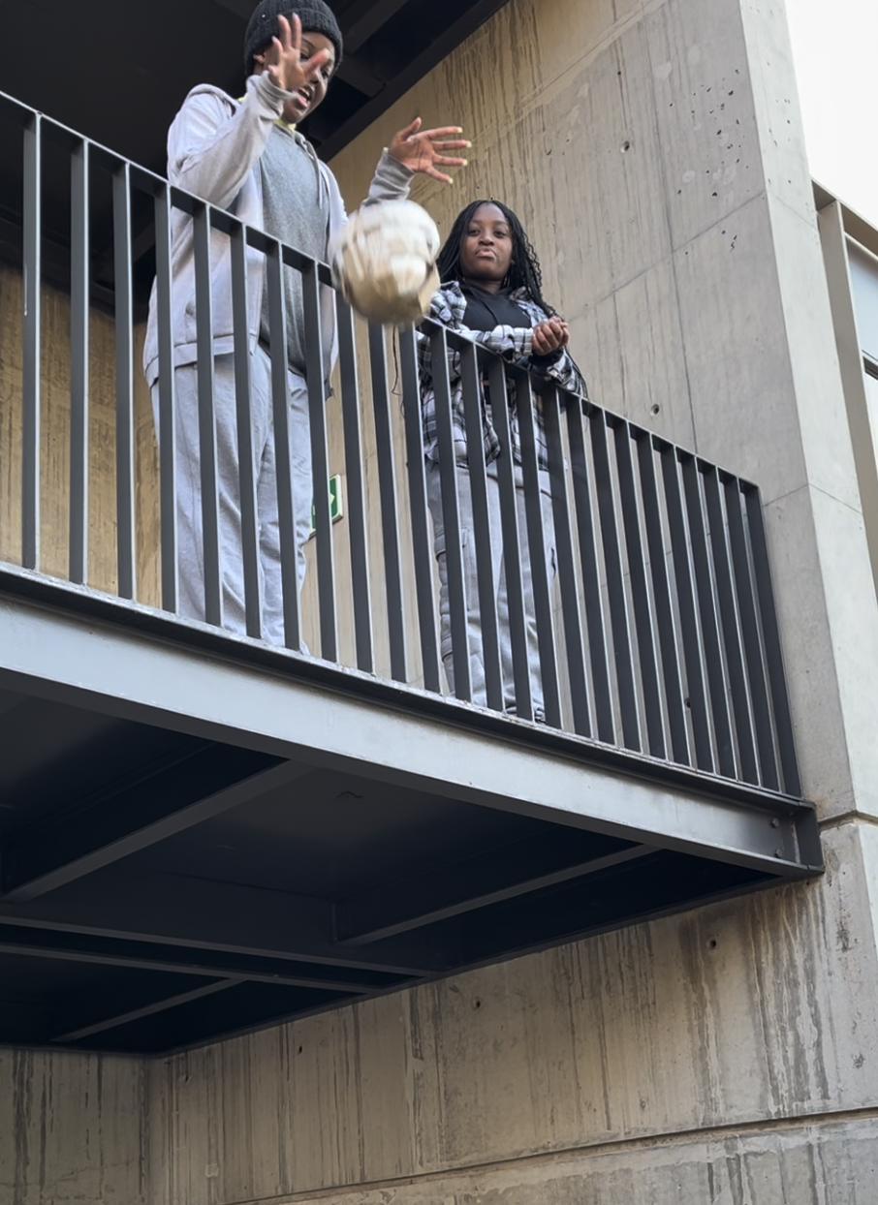
The evolution of Next Engineers:
Impact and how we measure it

Slide 3
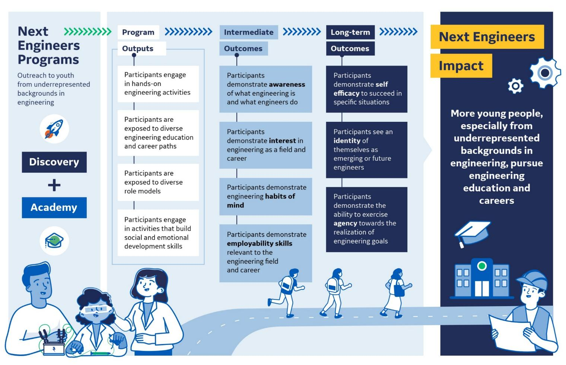
Next Engineers Theory of Change

Slide 4


How have Next Engineers students grown in their engineering awareness?
Discovery
Camp
Academy
Engineering Awareness: understanding of what engineering is, what engineers do, and the education and career pathways to become an engineer
Next Engineers models: original and current

Slide 5

How have Next Engineers students grown in their engineering awareness?
Discovery
Did students learn about engineering?
Discovery measures should focus on broader definition of Engineering Awareness.

Slide 6

How have Next Engineers students grown in their engineering awareness?
Discovery
Did students learn about engineering?
What goes into the new composite measure?
Engineering classes, activities, opportunities
Difference between engineering and other STEM
Different types of engineering and their careers
Engineering design process
What it's like to work as/with engineer
,
,
the work of engineers, and engineering career pathways?

Slide 7

How have Next Engineers students grown in their engineering awareness?
Camp
Did students learn about engineering?
Did students learn about the role and work of engineers?
,
the work of engineers, and engineering career pathways?
Similar to Discovery, our measure of Engineering Awareness within Camp was too narrow.

Slide 8
How have Next Engineers students grown in their engineering awareness?
Camp
Did students learn about engineering?
Did students learn about the role and work of engineers?
,
the work of engineers, and engineering career pathways?
,
engineering processes, and engineering pathways?
Notes:
I know the difference between the job of an engineer and a mathematician.
I know the difference between types of engineering fields.
I know how to apply the steps of the engineering design process.

Slide 9

How have Next Engineers students grown in their engineering awareness?
Academy
Did students learn about engineering?
Did students learn about the role and work of engineers?
Did students learn about the role and work of engineers, engineering processes and skills, and different engineering professions?
,
the work of engineers, and engineering career pathways?
,
engineering processes, and engineering pathways?
Academy students enter with awareness of what engineering is but not of engineering career pathways.
Notes:
Half of Cohort 1 and 2 students showed gains in awareness (with another 12% staying at the ceiling before and after Academy).
I know the skills needed for engineering careers.
Engineering is useful in helping to solve the problems of everyday life.
Engineers help make people's lives better.
Engineers are creative.
Engineers use science.
Engineers use mathematics.
There is more than one kind of engineer.
Engineers work in teams.

Slide 10

How have Next Engineers students grown in their engineering awareness?
Academy
Did students learn about the role and work of engineers?
Did students learn about the role and work of engineers, engineering processes and skills, and different engineering professions?
engineering education and career pathways (entry points, resources, navigation strategies)?
,
Revised Academy survey for Cohort 4 provides better starting measure of engineering awareness.
Academy students enter with awareness of what engineering is but not of engineering career pathways.
Notes:
A more sensitive measure of awareness shows a lower ceiling effect in Cohort 4 baseline data
We continue the focus of expanding their engineering skill and process knowledge but focus more intently in our survey on whether we are achieving goals to build awareness in education and career pathways
I know the high school and college education requirements to become an engineer
I know the training or work experience requirements to become an engineer
I know of community college, university, or technical school engineering opportunities that I can pursue to become an engineer.

Slide 11
How have Next Engineers students grown in their engineering awareness?
Did students learn about engineering?
Did students learn about the role and work of engineers?
Did students learn about the role and work of engineers, engineering processes and skills, and different engineering professions?
,
engineering education and career pathways (entry points, resources, navigation strategies)?
the work of engineers, and engineering career pathways?
,
engineering processes, and engineering pathways?
Next Engineers Camp “showed me that engineering isn't just about theory, but about collaboration and creatively turning ideas into tangible solutions.” – Cincinnati Camp Student

Slide 12


How have Next Engineers students grown in their engineering interest?
Engineering Interest: commitment to continue to learn about engineering, to practice engineering, and to consider engineering as a career pathway

Slide 13

How have Next Engineers students grown in their engineering interest?
Discovery
Did participation spark students’ interest to pursue more engineering experiences?
Discovery activities and tools capture our targets for growth in engineering interest.

Slide 14
How have Next Engineers students grown in their engineering interest?
Camp
Did participation spark students’ interest to pursue more engineering experiences?
Did participation motivate continued engineering learning?
Measurement focused too narrowly on academic interests related to engineering.

Slide 15
How have Next Engineers students grown in their engineering interest?
Camp
Did participation spark students’ interest to pursue more engineering experiences?
Did participation motivate continued engineering learning?
and greater enjoyment of engineering experiences?
Revised Camp survey captures more areas of growth for engineering interest.

Slide 16
How have Next Engineers students grown in their engineering interest?
Academy
Did participation spark students’ interest to pursue more engineering experiences?
Did participation motivate continued engineering learning?
Did participation motivate continued engineering learning, and desire to be an engineer?
and greater enjoyment of engineering experiences?
This measure focused too narrowly on commitment to being an engineer.

Slide 17

How have Next Engineers students grown in their engineering interest?
Academy
Interest continues to be high among incoming Academy students (unsurprisingly).
Did participation motivate continued engineering learning?
Did participation motivate continued engineering learning, and desire to be an engineer?
and greater enjoyment of engineering experiences?
exploration of engineering thinking, and post-secondary engineering pathways?

Slide 18
How have Next Engineers students grown in their engineering interest?
Did participation spark students’ interest to pursue more engineering experiences?
Did participation motivate continued engineering learning?
Did participation motivate continued engineering learning, and desire to be an engineer?
and greater enjoyment of engineering experiences?
exploration of engineering thinking, and post-secondary engineering pathways?
“Engineering is awesome and [during Discovery] you experience things you have not experienced.” – Johannesburg Discovery student

Slide 19


How have Next Engineers students grown in their engineering habits of mind?
Engineering Habits of Mind: capacity for creative problem finding, problem solving, improving, visualizing, adapting, and systems thinking.

Slide 20
How have Next Engineers students grown in their engineering habits of mind?
Discovery
Initially, we didn’t measure this for Discovery students.
Notes:
What percentage of Discovery participants learned something new about engineering?
4 out of 5 participants in Discovery learned something new about engineering through their participation

Slide 21
How have Next Engineers students grown in their engineering habits of mind?
Discovery
Did students engage in creative problem solving, improving, and visualizing?
So we added measures to track EHoM engagement to reflect the evolved ToC.

Slide 22
How have Next Engineers students grown in their engineering habits of mind?
Camp
Did students engage in creative problem solving, improving, and visualizing?
Did students learn EHoM competencies?
We learned that we need to think about specific competencies of EHoM
Notes:
I know the difference between the job of an engineer and a mathematician.
I know the difference between types of engineering fields.
I know how to apply the steps of the engineering design process.

Slide 23
How have Next Engineers students grown in their engineering habits of mind?
Camp
Did students learn
creative problem solving, improving, visualizing, adapting, and systems thinking?
… so we revised measures to track the EHoM targeted in Camp

Slide 24
How have Next Engineers students grown in their engineering habits of mind?
Academy
Did students engage in creative problem solving, improving, and visualizing?
Did students learn
Did students develop EHoM competencies?
creative problem solving, improving, visualizing, adapting, and systems thinking?
As with Camp, our initial outcome measure was too broad—we needed to improve our measurement approach.

Slide 25
How have Next Engineers students grown in their engineering habits of mind?
Academy
Did students learn
Did students develop
creative problem solving, improving, visualizing, adapting, systems thinking and problem finding competencies?
So we revised our definition of EHoM competencies so it focused on those targeted by Academy—and improved how we measure those competencies.

Slide 26
How have Next Engineers students grown in their engineering habits of mind?
Did students engage in creative problem solving, improving, and visualizing?
Did students learn
Did students develop
creative problem solving, improving, visualizing, adapting, and systems thinking?
creative problem solving, improving, visualizing, adapting, systems thinking and problem finding competencies?
“I learned that you’re not always going to find some sort of solution right away as an engineer and that it may take multiple attempts before making any headway on even the slightest problem.” - Greenville Academy student

Slide 27


How have Next Engineers students grown in their employability skills?
Engineering Employability Skills: confidence to apply the knowledge & skills necessary to navigate the transition from secondary education into postsecondary educational, training, & work opportunities.
This focus on employability skills as an outcome of Next Engineers represents an iteration of the model.

Slide 28
How have Next Engineers students grown in their employability skills?
Discovery
Did students practice:
people skills
communication
self-management?
As a brief intervention, Discovery aims to develop 3 of the 5 employability skillsets: people skills, communication skills, and self-management skills.
Notes:
Discovery activities develop 3 out of 5 employability skillsets:
People skills – I collaborated with others
Communication skills – I effectively communicated my ideas to the team
Self-management – I continued to work, and I kept a positive attitude despite setbacks or challenges
Composite score is based on the following 4 indicators:
% collaborated to complete design
% continued to work on design despite setbacks
% kept positive attitudes despite setbacks
% felt team understood what they were trying to communicate

Slide 29
How have Next Engineers students grown in their employability skills?
Camp
Did students practice:
people skills
communication
self-management?
Camp has been phased out but, theoretically, we would expect to see students engaging with all 5 employability skills

Slide 30
How have Next Engineers students grown in their employability skills?
Academy
Did students practice:
people skills
communication
self-management?
Did students develop confidence in applying:
people skills
communication
self-management
thinking skills
academic & career skills?
In Academy, we want to see students not just engaging with these skills but applying them

Slide 31
How have Next Engineers students grown in their employability skills?
Did students practice:
people skills
communication
self-management?
Did students develop confidence in applying:
people skills
communication
self-management
thinking skills
academic & career skills?
“[Academy] has bettered my ability to communicate with people I have previously not known, and I am now able to share ideas and communicate effectively.” – Staffordshire Academy student

Slide 32


How have Next Engineers students grown in their engineering identity?
Engineering Identity: committed to learning engineering, feeling confident in your knowledge about engineering and aptitude to apply engineering skills, recognizing that others see you as a potential engineer and/or as skilled in engineering

Slide 33
How have Next Engineers students grown in their engineering identity?
Discovery
Did participation ignite consideration of an engineering career?
Important to emerging identity is understanding there are ‘others like me’ in engineering

Slide 34
How have Next Engineers students grown in their engineering identity?
Discovery
Did participation ignite consideration of an engineering career?
and demonstrate belonging?
The new measure considers:
I would consider becoming an engineer.
I realize there are people like me in engineering.

Slide 35
How have Next Engineers students grown in their engineering identity?
Camp
Did participation ignite consideration of an engineering career?
Did participation strengthen engineering commitment, self-identification, and external recognition as a potential engineer?
and demonstrate belonging?
Camp tools capture our targets for growth in engineering identity.

Slide 36
How have Next Engineers students grown in their engineering identity?
Academy
Did participation ignite consideration of an engineering career?
Initial definition
Did participation strengthen engineering commitment and self-identification?
Revised definition
and demonstrate belonging?
Academy tools were not measuring all sub-constructs of engineering identity.

Slide 37
How have Next Engineers students grown in their engineering identity?
Academy
Initial definition
Did participation strengthen engineering commitment and self-identification,
Revised definition
engineering aptitude, and external recognition of engineering skills?
New composite measures Interest, Performance, and Recognition

Slide 38
How have Next Engineers students grown in their engineering identity?
Camp
Academy
Discovery
Did participation ignite consideration of an engineering career?
Did participation strengthen engineering commitment, self-identification and external recognition as a potential engineer?
Did participation strengthen engineering commitment and self-identification,
and demonstrate belonging?
engineering aptitude, and external recognition of engineering skills?
“I figured out how to understand my value as an engineer and also as a woman in STEM. Even though I might not look like the norm, I might not have the brain of a normal engineer, I still love to problem solve and build the products that could change the future.” – Cincinnati Academy student

Slide 39
How have Next Engineers students grown in their engineering agency?
Engineering Agency: capacity to take an active role in shaping one’s future by exercising self-efficacy, a growth mindset, intentional planning and forethought.
New to the current model of NE

Slide 40
How have Next Engineers students grown in their engineering agency?
Discovery
Did participation motivate students to pursue engineering?
We track emerging engineering agency as intent of further exploration.

Slide 41
How have Next Engineers students grown in their engineering agency?
Camp
Did participation motivate students to pursue engineering?
Did students pursue further engineering opportunities?
We track developing engineering agency through applications to Academy.

Slide 42
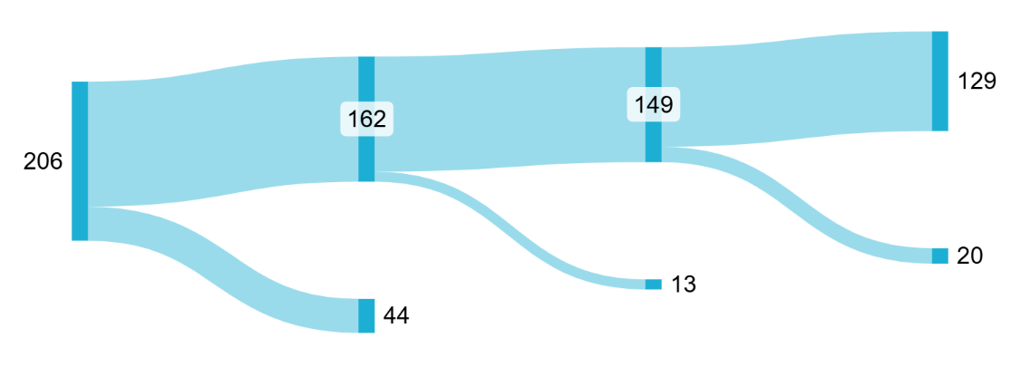
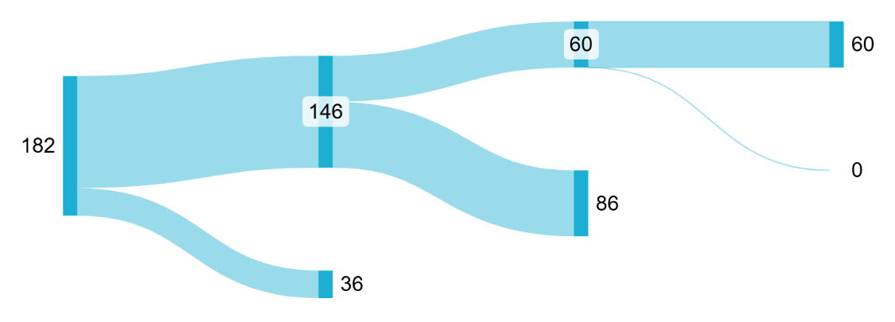
How have Next Engineers students grown in their engineering agency?
Academy
Graduated
Academy
Applied to Post-Sec
Enrolled Post-Sec
Cohort 1
Did students pursue further engineering opportunities?
Did students create and navigate a path to pursue engineering?
We measure consolidated engineering agency through the pursuit of an engineering career.
Cohort 2
TBD
Notes:
For any emergency edits, these were made at https://sankeymatic.com/ using the following code:
Cohort 1
Enrolled [162] Graduated - 79%
Enrolled [44] Did not graduate
Graduated [149] Applied – 92%
Graduated [13] Did not apply
Applied [129] Post-sec – 87% (63% of C1; 80% of Academy grads)
Applied [20] Did not enroll
Cohort 2
Enrolled [146] Graduated (80%)
Enrolled [36] Did not graduate
Graduated [60] Applied
Graduated [86] ? Status to be updated through the year
Applied [60] Post-sec
Applied [0] Did not enroll

Slide 43
How have Next Engineers students grown in their engineering agency?
Did participation motivate students to pursue engineering?
Did students pursue further engineering opportunities?
Did students create and navigate a path to pursue engineering?
“I believe that a road to success doesn't shout, I should go and look for it myself. I would like to use my knowledge and full participation on activities like those[we completed in Camp].” - Johannesburg Camp student

Slide 44


Next Engineers Impact (#/% of participants reporting change)
Awareness
Interest
EHoM
Employability
Identity
Agency
11,939 (82%)
12,832 (87%)
266 (89%)
277 (93%)
5,086 (35%)
236 (43%)
561 (56%)
340 (34%)
511 (51%)
-
430 (43%)
343 (20%)
74 (52%)
53 (37%)
76 (53%)
-
58 (40%)
209 (54%)

Slide 45

Inev: The Ideal Volunteer
Qualities:
Adaptable
Enthusiastic / Energetic / Engaging / Youthful Spirit
Passionate
Compliant
Knowledgeable
Reflection of the participants / Relatable
Non-Judgmental
Communicative
Prepared
Committed
Patient
Recruiter (for other volunteers!)

Slide 46
Data-Driven Impact with Adam Kostecki, Lauren Jarvis, and Jessica Baker

Slide 47
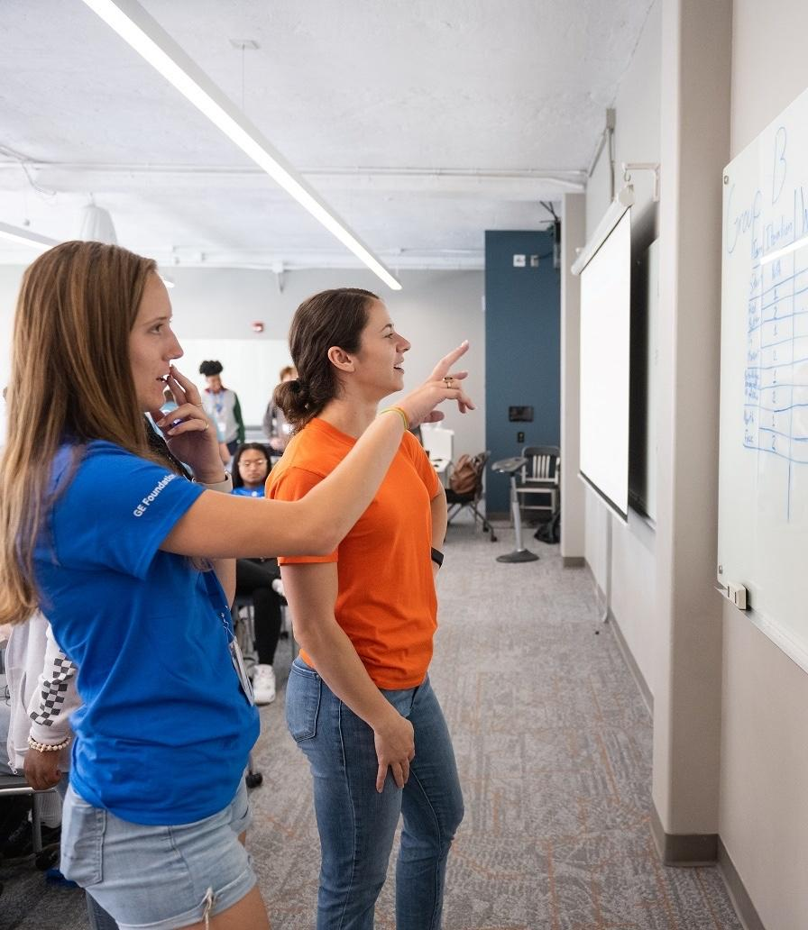
Introduction
Putting the Data to Work
How can we use our data to communicate the impact of Next Engineers in our communities?
Thinking about Next Engineers’ goal to inspire the next generation of engineers, how can effective communication help us achieve that goal?
How can we use data in storytelling to show Next Engineers’ impact to different audiences, including parents, participants, volunteers, and the public?
Engineering Camp Greenville
Photo Credit: Clemson University

Slide 48
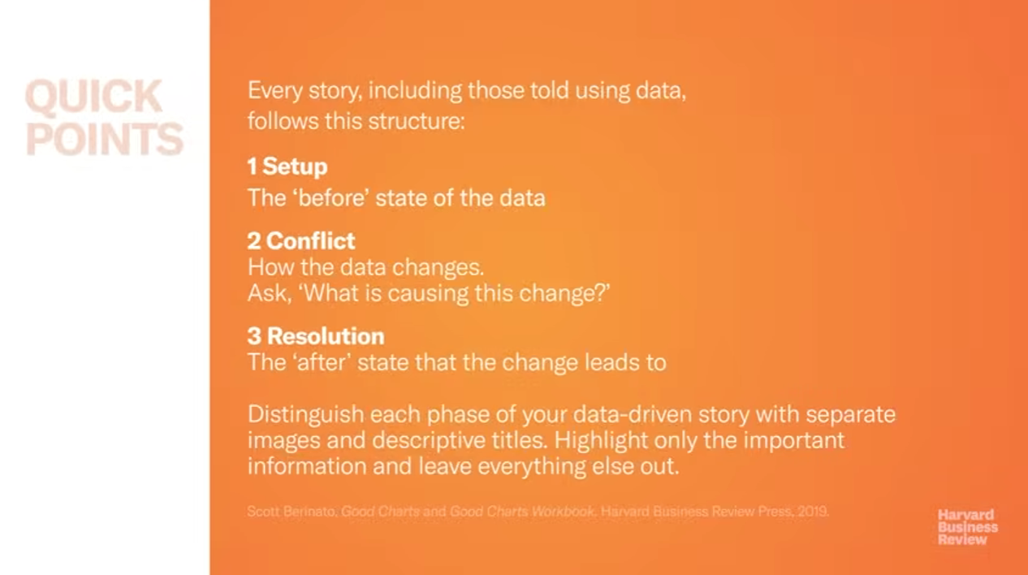

Slide 49
Key Messages
GE Aerospace
Next Engineers
It is GE Aerospace’s philanthropic mission to lift people up in the communities where we live and work.
Through Next Engineers, we are transforming our communities into global leaders in engineering.
Next Engineers supports and encourages young people as they explore engineering career pathways and prepare for higher education.
We are building the next generation of leaders who will drive our companies, fuel our innovation, and shape our country’s future.
Next Engineers goes beyond sparking interest in STEM — it’s cultivating an ecosystem where students, teachers, and communities thrive together.
GE Vernova
As GE Vernova pursues its mission of electrifying to thrive and decarbonize the world, the GE Vernova Foundation seeks to ensure the current and future workforce have the skills they need to succeed.

Slide 50
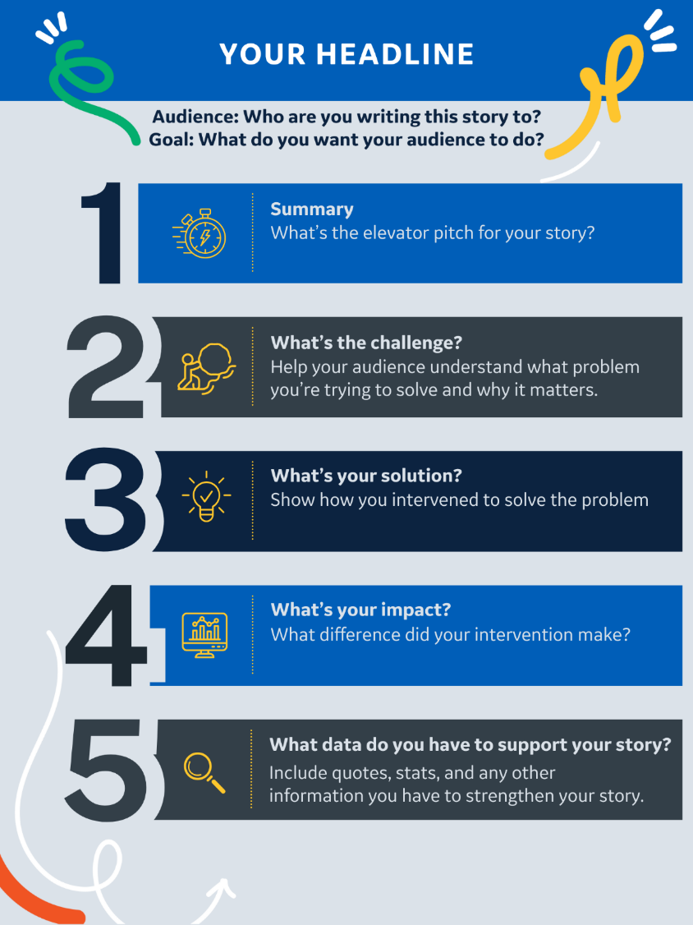
Create Your Storyboard
Here’s your challenge:
Using the data in front of you, as well as what you learned yesterday in the Evolution session, your team will create a storyboard.
Spend 10 minutes reviewing your data, discussing what you find most compelling, and planning what kind of story you want to tell
Take 30 minutes to create your storyboard! Using your large post-it paper, outline your story. Follow the template →
In your final 5 minutes, review your story and make any final changes before posting your story on the wall.

Slide 51
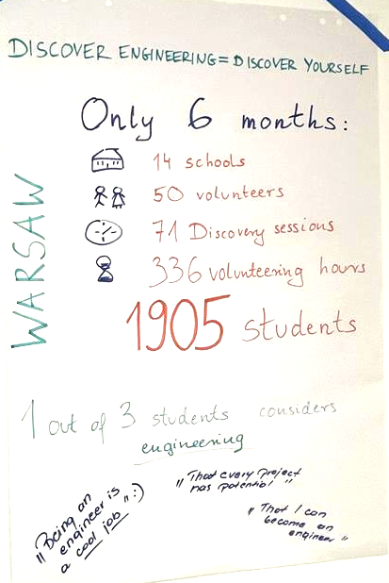
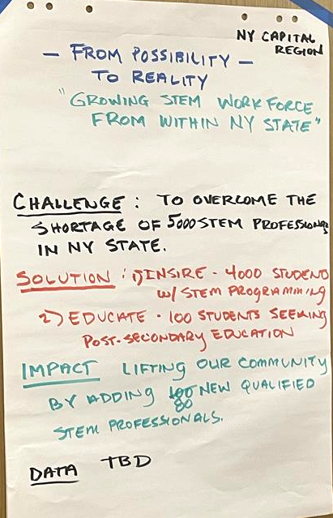
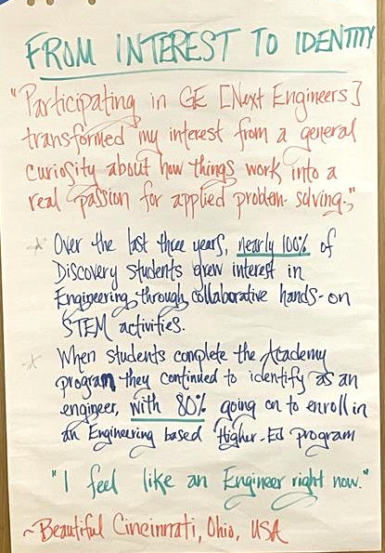
Stories

Slide 52
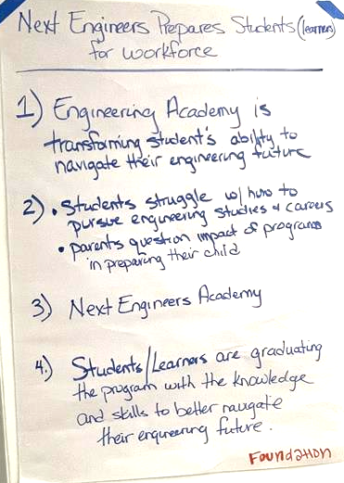
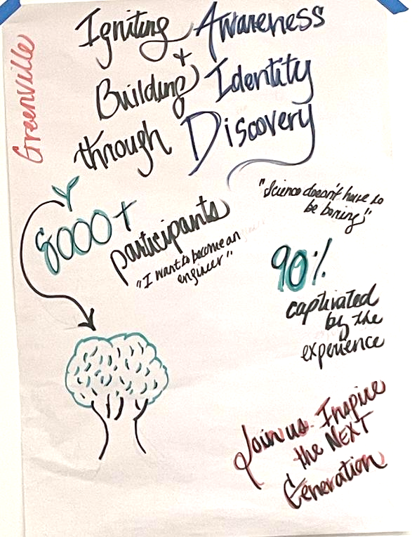
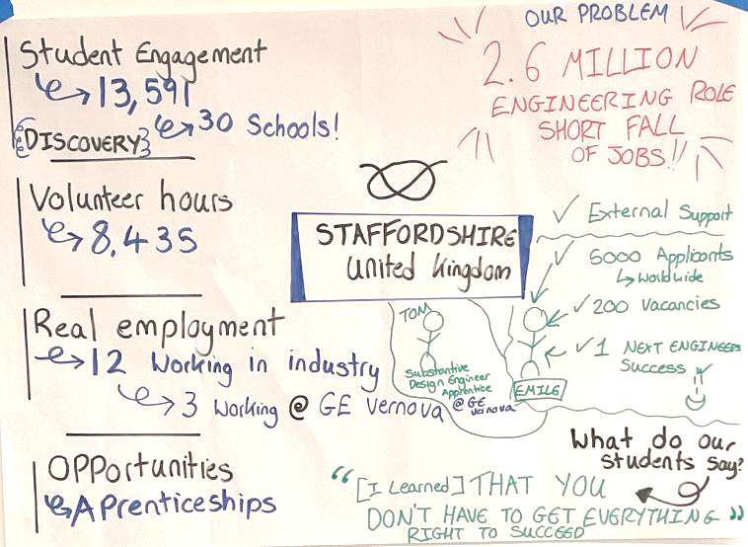
Stories

Slide 53
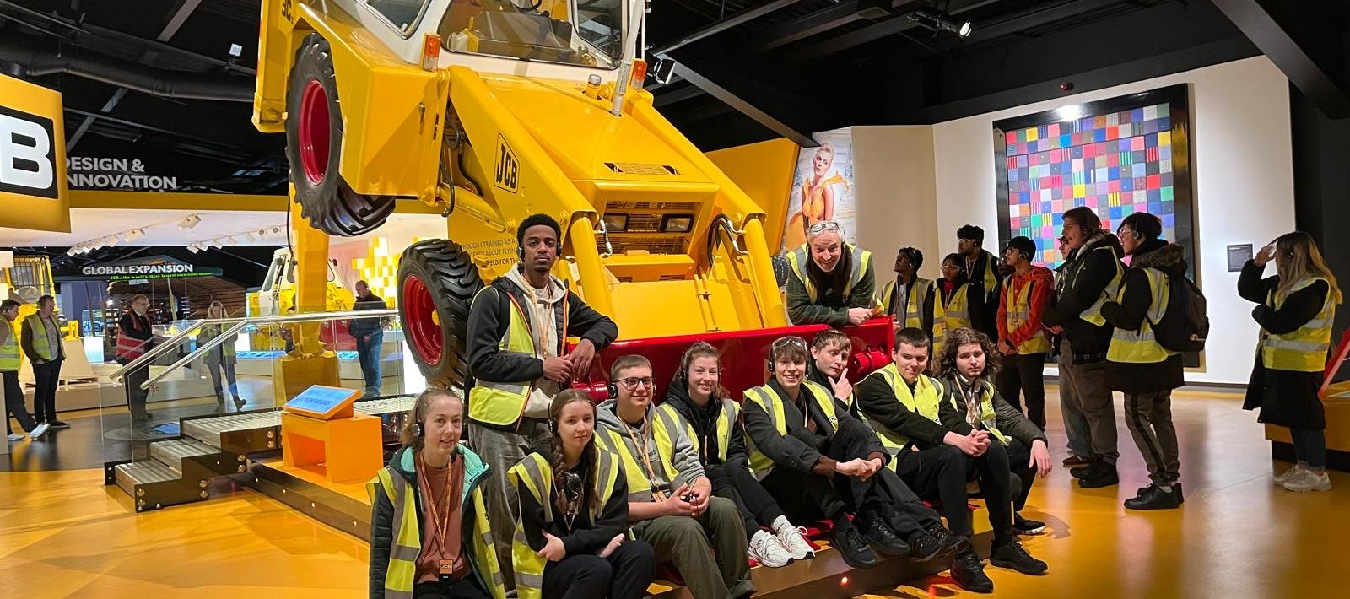
Program Focus: Engineering Academy
Staffordshire Engineering Academy
Photo Credit: TILG

Slide 54
What percentage of
Engineering Academy Cohort 1 graduates enrolled in post-secondary engineering programs?
80%

Slide 55
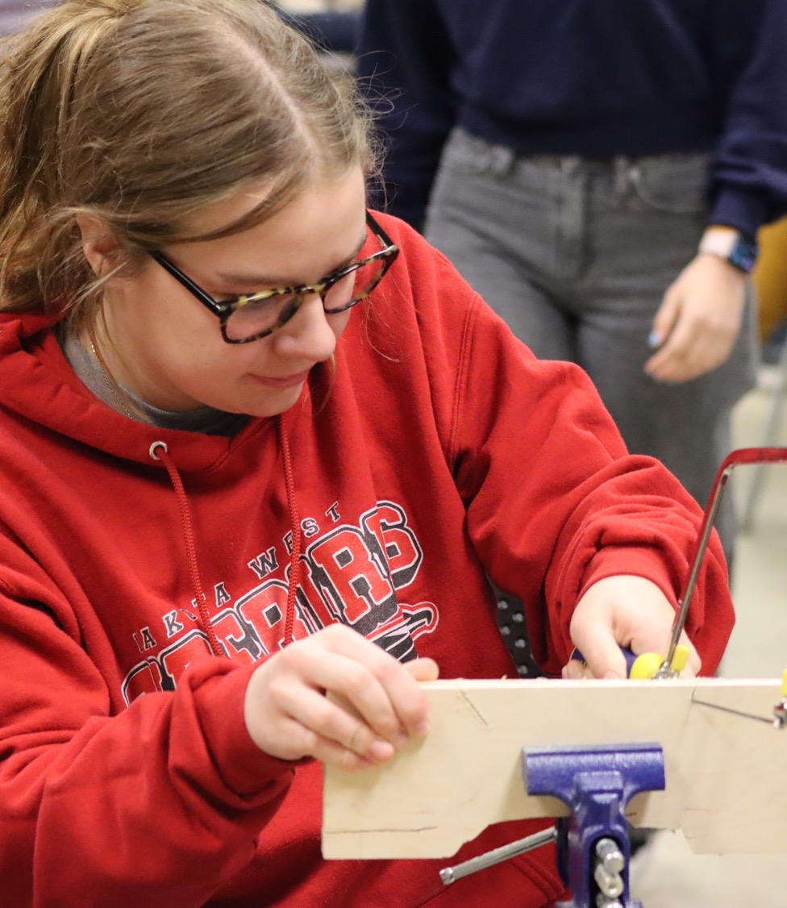

Engineering Academy
A transformative learning experience
Students (ages 15 to 18) learn to think and act like engineers and prepare to advance to post-secondary education. Students will participate in:
Immersive engineering design challenges
Interactive and practical sessions on career exploration and higher education preparation
Dedicated time for academic and career planning
Eligible students who complete the program and enroll in post-secondary engineering programs will receive a partial scholarship from the GE Aerospace Foundation
Cincinnati
Photo Credit: University of Cincinnati

Slide 56

A brief history of Engineering Academy
2021
2022
2024
2025
Next Engineers initiative launch
Engineering Academy 1.0 kick off in Cincinnati, Greenville, Johannesburg, and Staffordshire
GE Aerospace announces the expansion of Next Engineers; Academy 2.0 model created
Engineering Academy 2.0 kick off in Cincinnati and Warsaw
Notes:
Kendra
Before going into the changes to Academy, let’s review a brief timeline:
2021 – Next Engineers launches and the team develops the original, 3-year Academy curriculum (1.0)
2022 – Academy 1.0 launches in four cities
2024 – GE Aerospace announces a 7-year expansion; FHI 360 team presented with an opportunity to develop a new Academy model
2025 – Academy 2.0 is launched with Warsaw and Cincinnati

Slide 57



Considerations
Less time
Updated Theory of Change
Data-Driven Changes
Notes:
Kendra
A few key considerations that guided the update:
Less Time – Due to budget constraints, Academy would be cut down to 2 years instead of 3. However, implementation had also indicated that students found managing Academy and the final school year commitments difficult. Creating a 2-year, 5-unit model would offer more scheduling flexibility and leave students free to focus more on end of school.
Updated ToC – As the MERL team was updating the ToC for the entire project, we wanted to ensure that the program design, content, and implementation would lead to the outputs in a more intentional way
Data-Driven Changes - Also thanks to the MERL team we had a lot of rich data about the program from interviews, focus groups, surveys, and observations. We wanted to incorporate the best practices and address challenges highlighted by community partners, facilitators, and students.

Slide 58
Engineering Academy Reimagined
INTEGRATED COMPONENTS
STRUCTURED BUT ADAPTABLE
Organized the curriculum into 5 units
Selected a specific set of activities for implementation
SCAFFOLDED LEARNING
EQUIPPED FACILITATORS
Recommended sequence of activities
Extended onboarding and clearer expectations
Notes:
Dylan
Rather than just condensing the program, we took the time to reimagine Academy by prioritizing these essential elements:
Integrated components – We heard that it was challenging to fit career readiness activities into the schedule alongside the engineering design challenges. We looked at the program more wholistically and organized it into 5 units that includes, and gives space for, each type of activity, including the Pathways Planning time for students to explore different paths into engineering and plan next steps. In addition, this more integrated approach helps facilitators and students more clearly see the links between the employability skills and their direct application into the practice of engineering and how the design challenges also offer opportunities to practice these skills.
Structured but Adaptable – There were dozens of activities for facilitators to choose from, but it was not practical for them to review all of them and most sites used the same set each year. We refined the activity library and identified a few specific places where sites can choose. The recommended structure for each unit hopefully makes scheduling easier while still giving facilitators the ability to adapt the program to their context.
Scaffolded learning – Academy is a developmental experience for students. Therefore we organized the units and their activities in a way that is meant to progressively build students’ knowledge, skills, and confidence, moving them from simpler, more concrete concepts to more abstract and sophisticated ones and into greater degrees of agency and self-direction.
Equipped facilitators – We recognized that facilitators bring Academy to life and we wanted to ensure that they had a deeper understanding of the program design and were more involved in the customization of the program for their students. The facilitator onboarding was extended to allow more time for discussion and collaboration, and to help facilitators make the required adjustments.

Slide 59




Engineering Academy Program Structure
Unit Overview
Academy 1.0
Academy 2.0
240 hours
Three years
30-50 students per cohort
Activities organized by year
1-2 facilitators
Aligned to Five Building Blocks
180 hours
Two years
30 students per cohort
Activities organized into
5 learning units
2 lead facilitators
Aligned to updated Theory of Change
Unit Introduction
Employability Skills activities
Engineering Design Challenge activities
Pathways Planning Sessions
Notes:
Dylan
2.0 is the current structure that Cincinnati and Warsaw are implementing and that new cohorts in Bengaluru and New York Capital region will be starting in 2026.
As we continue gathering data and feedback we will learn more and continue to refine the model.

Slide 60


Engineering Career Pathways Webpage
Click the link or scan the QR code to access the Landing page:
Click the link or scan the QR code to access the U.S. Pathways page:
https://www.nextengineers.org/becoming-engineer
https://www.nextengineers.org/engineering-pathways-united-states

Slide 61

Engineering Career Pathways - Feedback
Click the link or scan the QR code provide feedback on the Engineering Career Pathways webpages:
https://forms.cloud.microsoft/r/N1DSqSBiXx?origin=lprLink

Slide 62
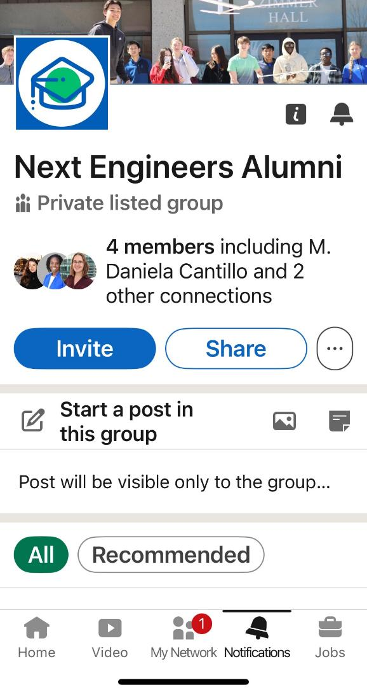
Engineering Academy Alumni Communications
Internal Alumni List
External Alumni List
LinkedIn Group
Administrated by FHI 360.
Shared with Community Partners and City Teams.
Maintained by FHI 360.
Used by FHI 360 only for ongoing data collection.
Community Partners, and Volunteers can join. All posts are reviewed by the administrators.
Students will opt-in and can opt-out anytime. Updated by FHI 360 as needed.
Used to announce alumni events, webinars, etc.
Network of alumni to connect with each other and Next Engineers staff and volunteers.
To be created.

