Slide 1
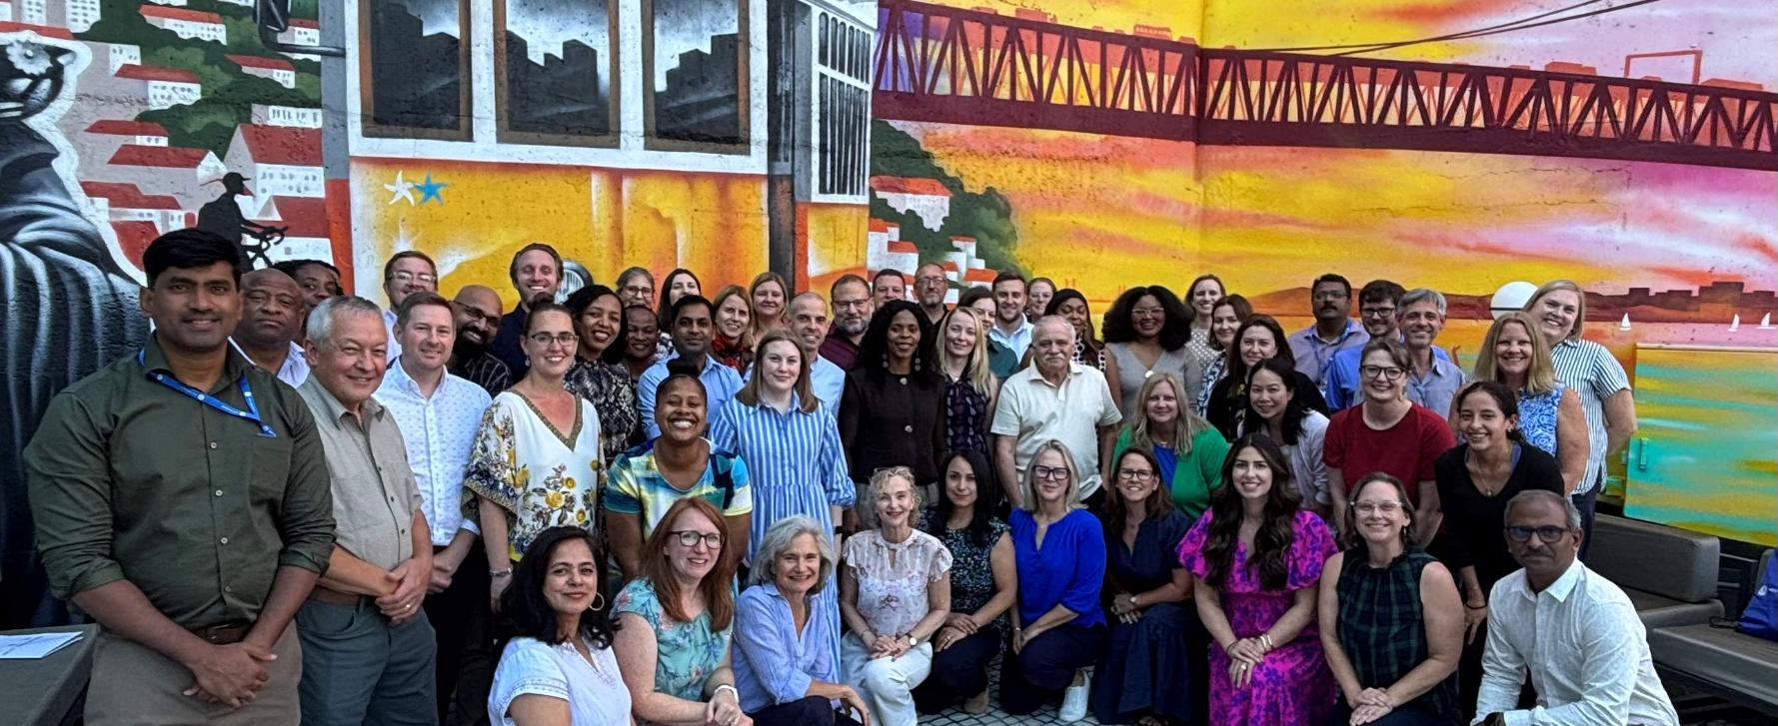
Participant feedback summary Next Engineers Partners’ Workshop September 16-18 Lisbon, Portugal

Slide 2
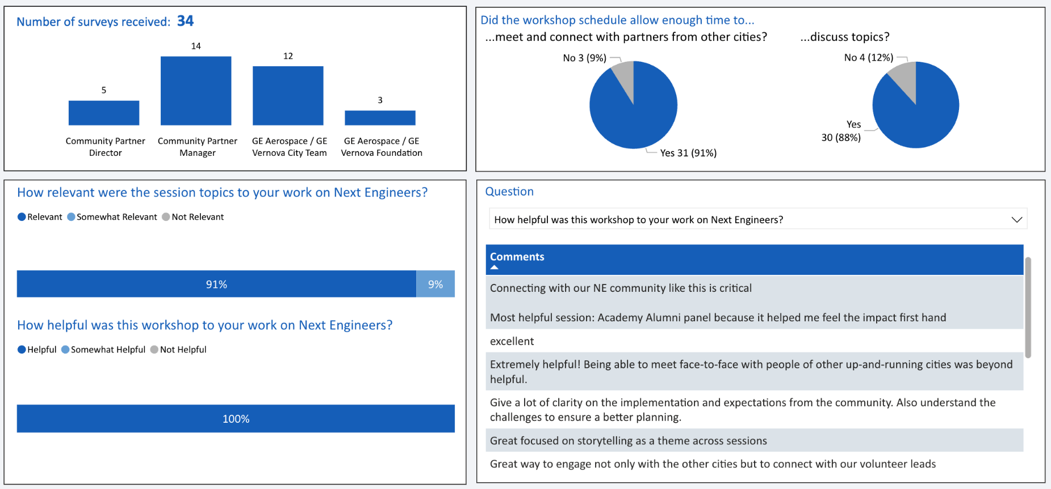
(85%)
Responses

Slide 3
Learnings
Many sites experience similar challenges, and this is an opportunity to share solutions (9)
Volunteer recruitment & engagement strategies (6)
Clarity on partner roles and responsibilities (5)
Invigorated spirit, networking, new inspiration, commitment and encouragement (6)
How to tell our story / impact (internal to GE and external to community) (4)
Customizing materials/programs to best meet community needs (3)
General best practices shared / standard work ethic (2)
New Academy 2.0 model (2)
Next Engineers impact (2)
Scaffolding & expansion
Wrapping up current program in cities
Engineering Discovery implementation techniques
Networking opportunities
Global collaboration
Everything! We still have a lot to learn
Consider how to involved parents more
“The impact.” – City team member
“That we’re a global community, that we have similar problems and different solutions, and that we have one goal and I'm proud of it and thankful.” – Community partner manager
“I had a very surface level understanding of the program previously and I am thankful to have gone deeper throughout the week.” – Foundation member

Slide 4
Most and least helpful sessions
Most helpful
Communicating data-driven impact (10)
Role-Alikes (Community Partners) (4)
Engineering Academy discussion (3)
All (3)
Focus on the Future (4)
Academy Alumni Panel (2)
Interaction among new & current sites (2)
Cross-Site Collaboration (2)
Engineering Discovery discussion (2)
Critical Load Engineering Discovery activity
GE Aerospace: location links
Meetings within cities
Role-Alikes (City Teams)
Role-Alikes (Directors)
Least helpful
None (8)
Focus on the Future (for GE Aerospace) (5)
Academy alumni panel (“would like to hear more”; “not every person needs to answer same question”; 2)
Next Engineers Impact (“it’s more than a number, it’s a transformational journey”)
Storytelling (“not relevant to job”)
Sharing of different sites (“Academy/Discovery focus sessions?”)

Slide 5
Potential improvements
Length: Fit Thursday’s agenda into Tuesday or Wednesday (3); add another day (1)
Logistics: WhatsApp group for conference participants to connect
Planning: Meal options for group dinner; colored nametags for organizations/roles; venue with smaller spaces/better acoustics; avoid back-to-back virtual sessions
Preparation: Pre-work for partners and city teams to allow more time during the sessions to walk out with more formal plans with the discussed changes
Sessions:
More sessions from/with community partners, alumni, and volunteers;
Impact stories/panels from teachers and parents;
Greater discussion topics including Academy 2.0, role-alikes, design challenges, and terminology (demographics);
More time within city teams, time with teams from comparable countries;
General introductions; new site introductions; Philanthropy 101
Open discussion for key topics/questions that arise during the day

Slide 6
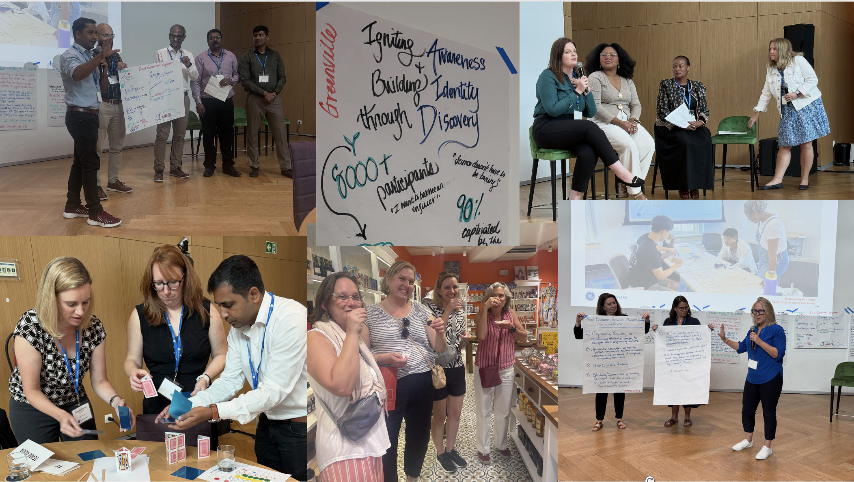
Here’s to a great Year 5!

